Slide 1


Learn about Bitcoin
Jeffrey J. Song, PhD, CSO, Coinplug Inc.

Slide 2
Current status of Bitcoin 2015

Slide 3
Key Bitcoin Adoption Metrics
 |  | Quarterly |  |  |  | Last 12 Months
 |  | Dec-14 | Sep-14 | Q/Q Δ |  | Dec-13 | Δ
Commerce
 | Wallets | 7,948,272 | 6,559,978 | 21% |  | 3,194,584 | 2x
 | Merchants | 82,000 | 76,000 | 8% |  | 35,903 | 2x
 | Merchants’ annual revenue ($bn) | 180 | 86 | 109% |  | 0 | N/A
 | ATMs | 341 | 251 | 36% |  | 4 | 85x
 | Unique bitcoin addresses | 157,377 | 184,554 | -15% |  | 108,166 | 45%
Industry
 | All-time VC investment ($m) | 432.7 | 302.9 | 43% |  | 97.9 | 4x
 | Number of VC-backed startups | 83 | 68 | 22% |  | 30 | 3x
Media
 | Mainstream media mentions | 673 | 687 | -2% |  | 2,889 | -76%
Technology
 | Network hash rate (billion/second) | 335,365,290 | 249,839,180 | 34% |  | 9,920,977 | 34x
 | Github no. of updated repositories | 23,249 | 18,753 | 24% |  | 4,410 | 5x
Valuation
 | Bitcoin market capitalization ($bn) | 4.3 | 5.2 | -17% |  | 9.3 | -54%
Sources and notes: CoinDesk, Blockchain.info, BitcoinPulse, Github, Coin ATM Radar. Figures are cumulative from start of records, except unique bitcoin addresses and media mentions, which are figures for the quarter ending that month.

Slide 4
Total Exchange Trading Volume Increased by Over 50%
Total Bitcoin Trading Volume (BTC)
Total Bitcoin Trading Volume ($bn)
56%
57%
Sources: CoinDesk, Blockchain.info, Bitcoinity

Slide 5
2014 Bitcoin Venture Capital Investment
2014 bitcoin VC investment:
Total VC investment in cryptocurrency startups to date:
$335m
$433m
2013 bitcoin VC investment:
Increase in total to-date VC investment from end of 2013:
$96m
+342%
Source: CoinDesk (www.coindesk.com/bitcoin-venture-capital/)

Slide 6
2014 Bitcoin VC Investment Surpassed Early-Stage Internet Investment
*Includes first sequence venture deals but excludes late-stage 1995 Internet investments ($257.6m). For additional disclosure on methodology see www.coindesk.com/following-money-trends-bitcoin-venture-capital-investment/
Sources: CoinDesk, PricewaterhouseCoopers

Slide 7
































The Bitcoin Startup Ecosystem: Six Different Bitcoin Company Categories
Wallets
Exchanges
Universal
Payment Processing
Financial Services
Mining

Slide 8
140,000 Bitcoin-Accepting Merchants Forecast by End of 2015
Total merchants Forecasted merchants
Sources and notes: total current merchants based on data from Coinbase and BitPay. Historical Coinbase data provided by BitcoinPulse. BitPay historical data between new merchant press release announcements of 10,000 (16th Sep 2013), 20,000 (13th Jan 2014) and 30,000 (28th May 2014), respectively, calculated using linear interpolation.

Slide 9
Companies Representing >$180 Billion in Annual Revenue Now Accept Bitcoin
Top 10 Largest Bitcoin-Accepting Retailers
Rank | Company | Annual Revenue ($bn)
1 | Microsoft | 86.8
2 | Dell | 56.9
3 | Dish Network | 13.9
4 | Expedia | 5.0
5 | Intuit | 4.5
6 | Monprix* | 4.3
7 | Time Inc.** | 3.4
8 | NewEgg | 2.8
9 | Overstock | 1.3
10 | TigerDirect* | 1.0
 | Total | $179.9
*Monprix is a private company; most recent revenue data is from 2005. TigerDirect estimate provided by parent company investor relations. Other divisions that are part of a larger parent organization, but do not break out individual divisional revenues, are excluded.
**The revenue is Time Inc. FY 2013 revenue
Sources: CoinDesk, Coinbase, BitPay, companies’ annual reports

Slide 10
Approximately 12 Million Bitcoin Wallets Forecast by End of 2015
R² = 0.971
Total Wallets Forecasted Wallets
Sources and notes: total wallets based on data from Blockchain.info, MultiBit, Coinbase, Andreas Schildbach (Android Bitcoin Wallet developer). Historical Coinbase data provided by BitcoinPulse.

Slide 11
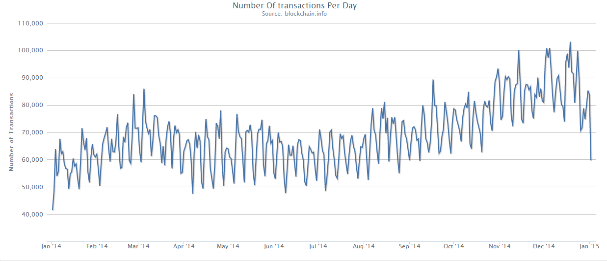
Daily Bitcoin Transactions Passed 100,000 for the First Time in Q4
Questions linger over how significant a milestone this is, given uncertainty over how many of these transactions represent bona fide economic activities
Source: Blockchain.info

Slide 12
Approximately 750 Bitcoin ATMs Forecast by End of 2015
R² = 0.973
Total ATMs Forecasted ATMs
Sources: CoinDesk, CoinATMRadar

Slide 13
How Bitcoin Works?

Slide 14
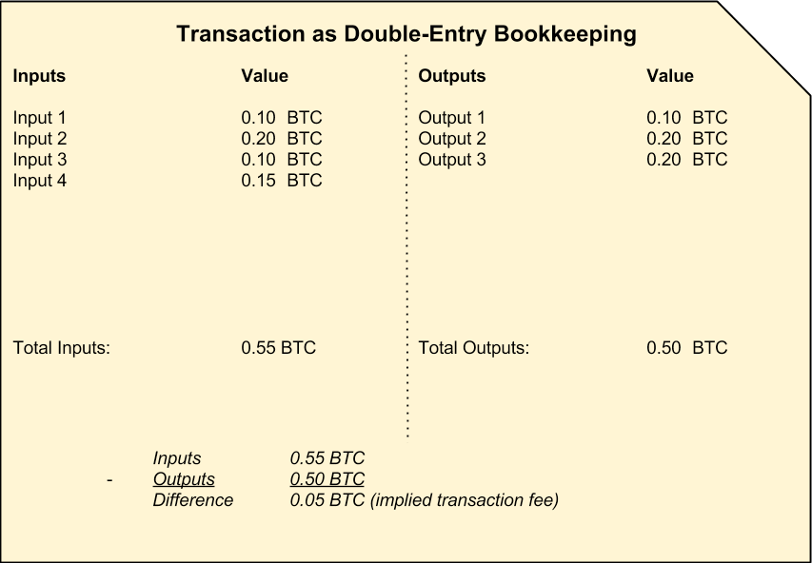
Bitcoin Transaction
Transaction as double-entry bookkeeping

Slide 15
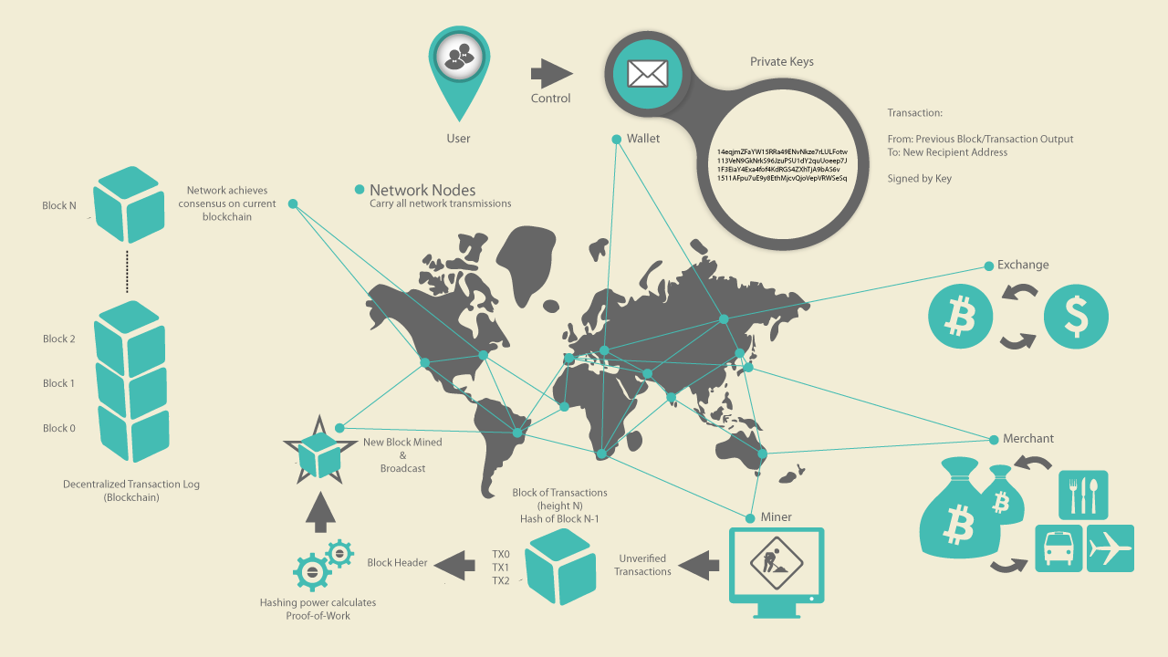
Bitcoin Overview
Trace a single transaction

Slide 16
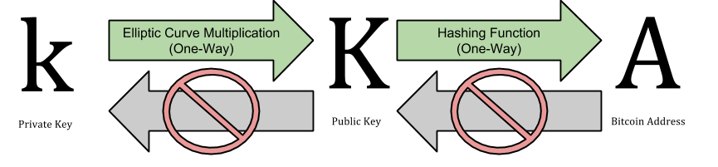
Private and public keys
Impossible to guess the private key

Slide 17


Multi-Signature Wallet
2-of-3 Multi-Signature Wallet
Deposit funds
is the same as depositing funds into a standard wallet
Withdraw funds
requires at least 2 of the 3 keys to sign
Bitcoin p2p Network
originator
Signer #1
Signer #2
Transaction
No Signature
Transaction
Signature #1
Transaction
Signature #1
Signature #2
broadcasts

Slide 18




Private Key Management
Bitcoin p2p Network
service
service
Client side wallet
Web wallet
Multi-sig wallet
Third-Party Vault

Slide 19
Blockchain

Slide 20
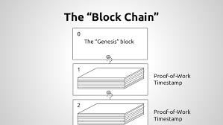
The Genesis Block
Q: What is the Genesis Block?
The first block in the blockchain
Created in Jan. 3, 2009
Common ancestor of all the blocks
Hidden message within it → The Times headline
Hidden message
"The Times 03/Jan/2009 Chancellor on brink of second bailout for banks.”
Q: What will happen if we change any bit in the Genesis Block?

Slide 21
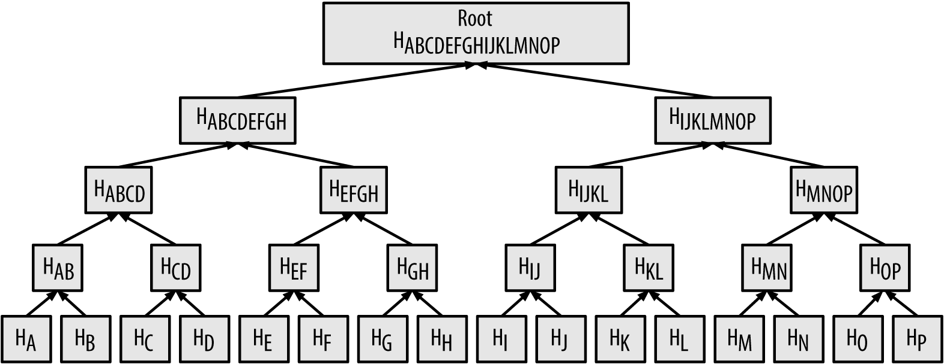
Finger Print of all Transactions
Merkle Root: Summary of all the transactions in the block
Used to verify whether a transaction is included in a block
32 bytes
Stored in block header
H_{x}: Unique ID of Transaction X
H_{A} = SHA256(SHA256(Transaction A))
H_{AB} = SHA256(SHA256(H_{A}:H_{B}))
H_{ABCD} = SHA256(SHA256(H_{AB}:H_{CD}))

Slide 22
Block Chaining
Block 60
Block 61
Block 62
Block 63
Block header hash
0000004e0b
Block header hash
00000014de
Block header hash
0000006790
Block header hash
0000003f73
Previous block
000000432f
Merkle Root
000000ab12
Timestamp
2015-01-30 10:00:00
Difficulty
1180923
Nonce
924591
Previous block
0000004e0b
Merkle Root
000000a149
Timestamp
2015-01-30 10:10:00
Difficulty
1180923
Nonce
14de28
Previous block
00000014de
Merkle Root
00000074eb
Timestamp
2015-01-30 10:20:00
Difficulty
1180923
Nonce
6790cb
Previous block
0000006790
Merkle Root
000000527b
Timestamp
2015-01-30 10:30:00
Difficulty
1180923
Nonce
a8461e
Block
header
Target
00000ffff
Transaction
cb112833c2
Transaction
c07810dcab
Transaction
1f80022005
Transaction
ca62b4004e
Transaction
3045022100
Transaction
b8cd2de76a
Transaction
65c92ac2d9
Transaction
c0de69c081
All Transactions
Transaction
60d794dcec
Transaction
bc8a07f519
Transaction
2144c8454a
Transaction
240104d864
Time
10 min
10 min
10 min
10 min

Slide 23
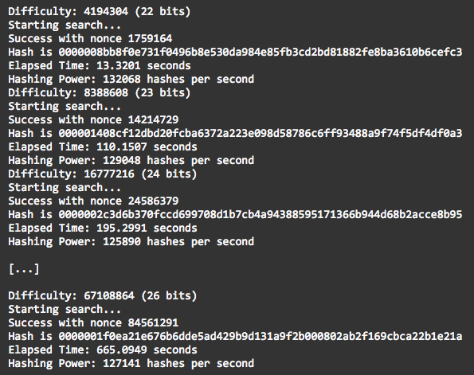
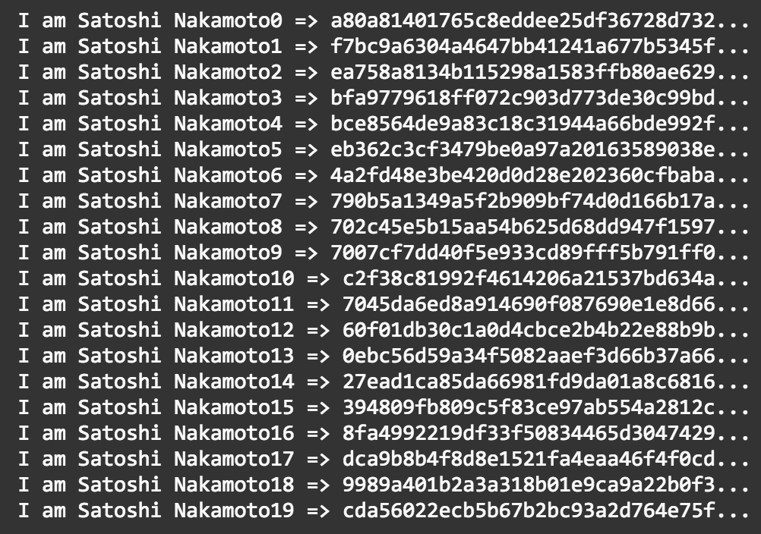
Mining Block
Mining == Hashing “Block Header” to find a hash smaller than target
Variable: “Nonce”
Constants: “All other fields”
Nonce
Block header
Block header hash

Slide 24
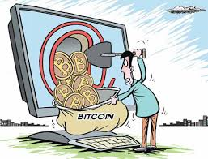
Mining
Goals of Mining
Secure the Bitcoin system
Network-wide consensus without a central authority
Money supply
Rewards to miner
New coins
Transaction fees (currently 0.5% or less)
Rewards (halved every 210,000 blocks)
Starts at 50 BTC per block in Jan. 3, 2009
Halved to 25 BTC in Nov. 2012
All BTCs at 13.44 million blocks
2,099,999,997,690,000 satoshis
After 2140, no new Bitcoins will be issued
“Decentralized security mechanism”
“Decentralized financial clearinghouse”

Slide 25
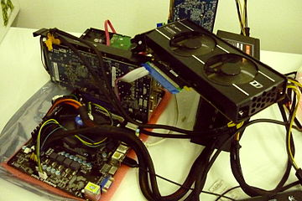
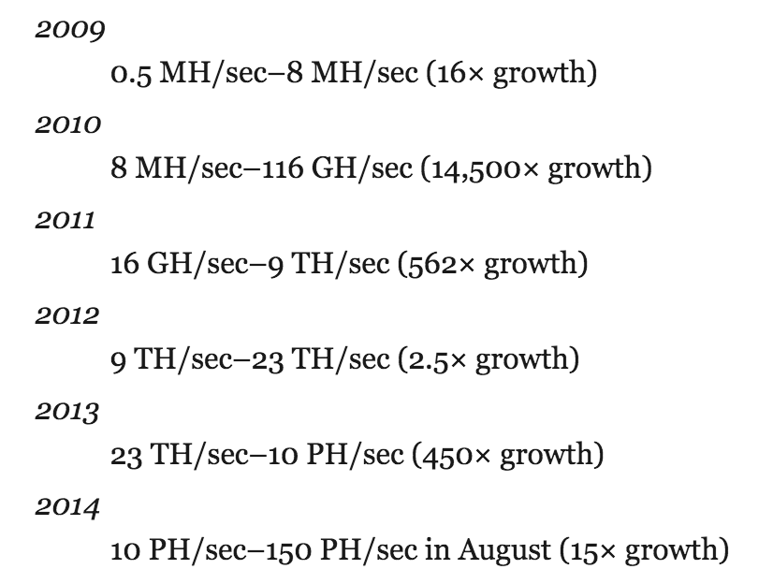
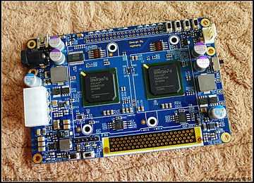
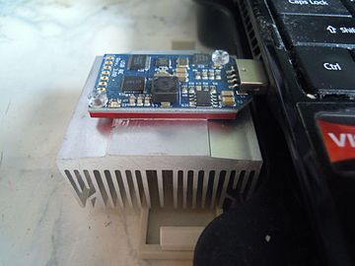
Mining and the Hashing Race
First 5 years of operation
CPU only
GPU & FPGA
ASIC
No more giant leaps left

Slide 26
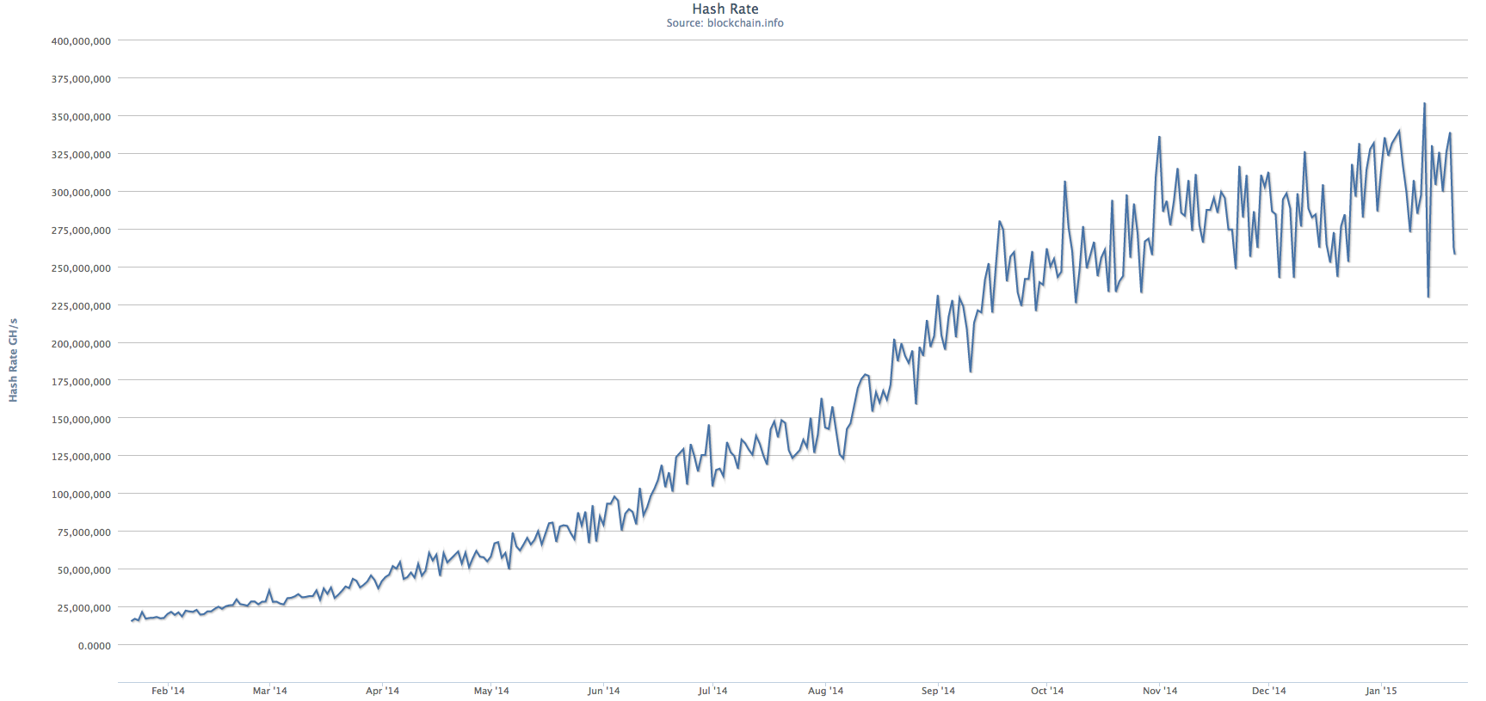
How much power do you need to spoil blockchain?
Current Total Computation Power of Hashing in Blockchain
≈ 300 PH/sec = 300,000,000,000 MH/sec
Current 1 PC Computation Power of Hashing
≈ 1MH/sec

Slide 27
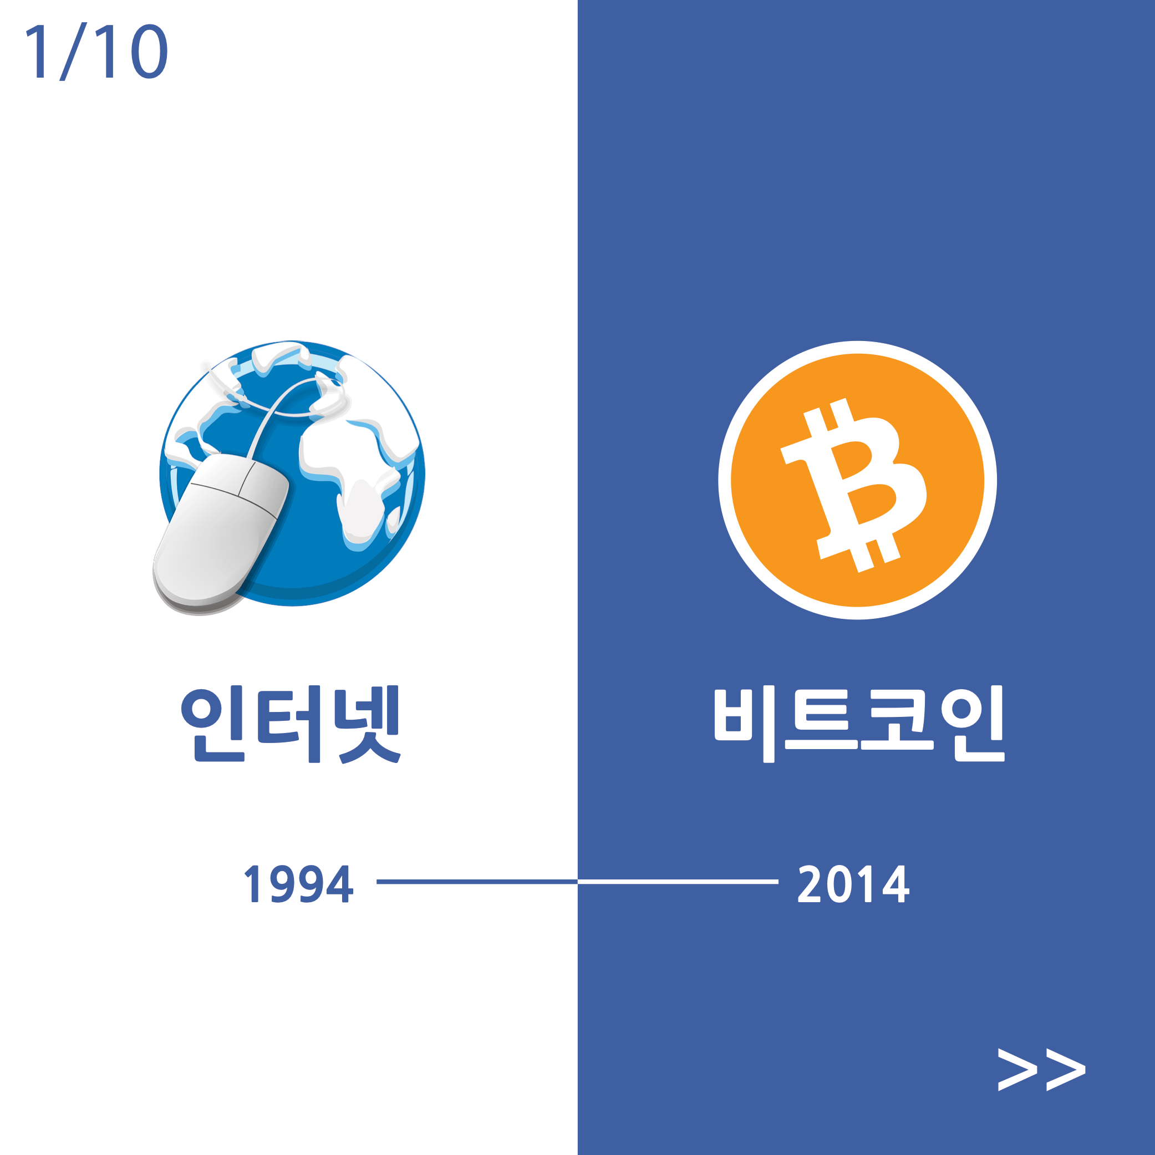

Slide 28
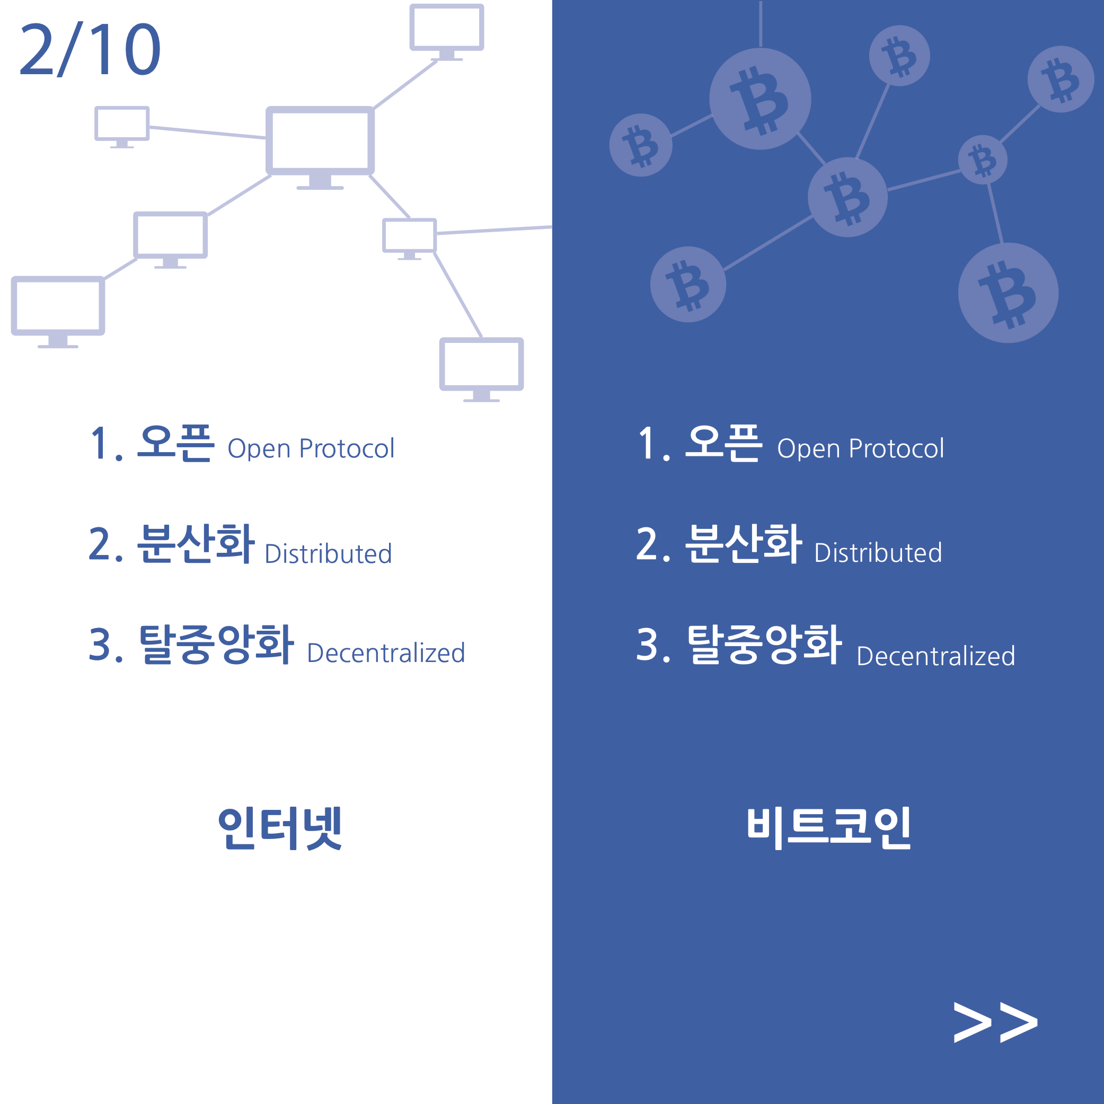

Slide 29
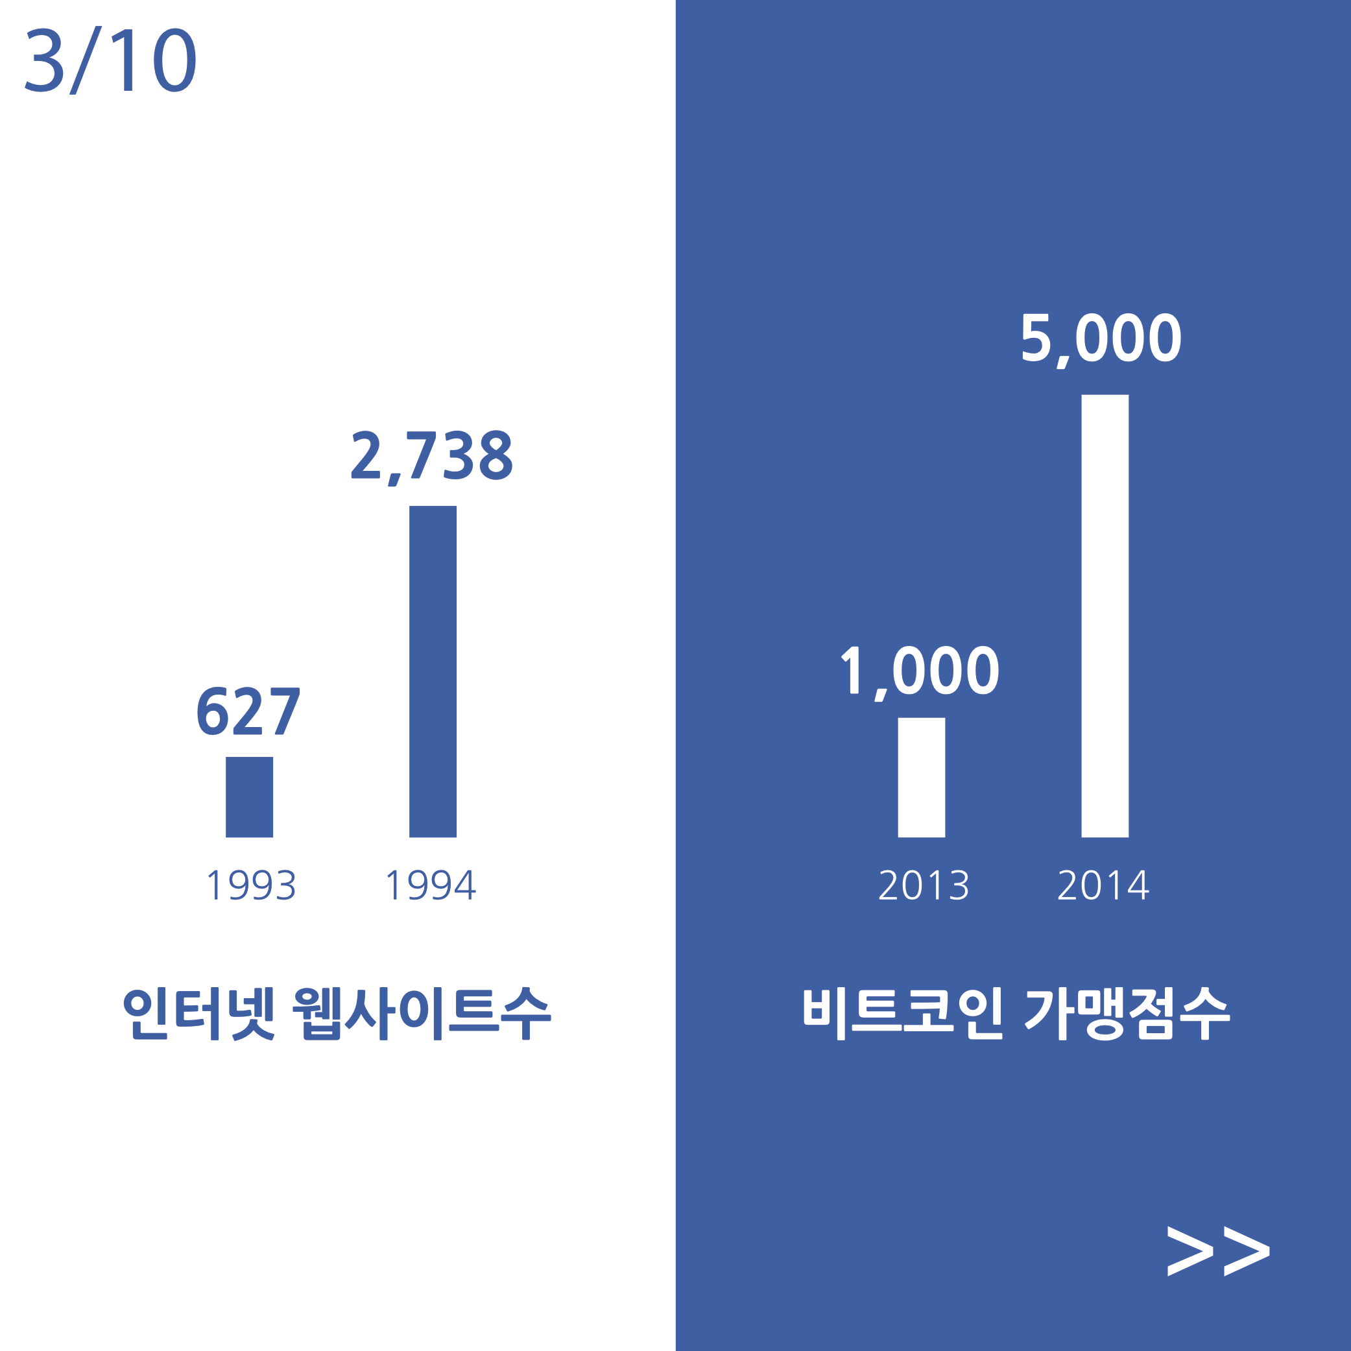

Slide 30
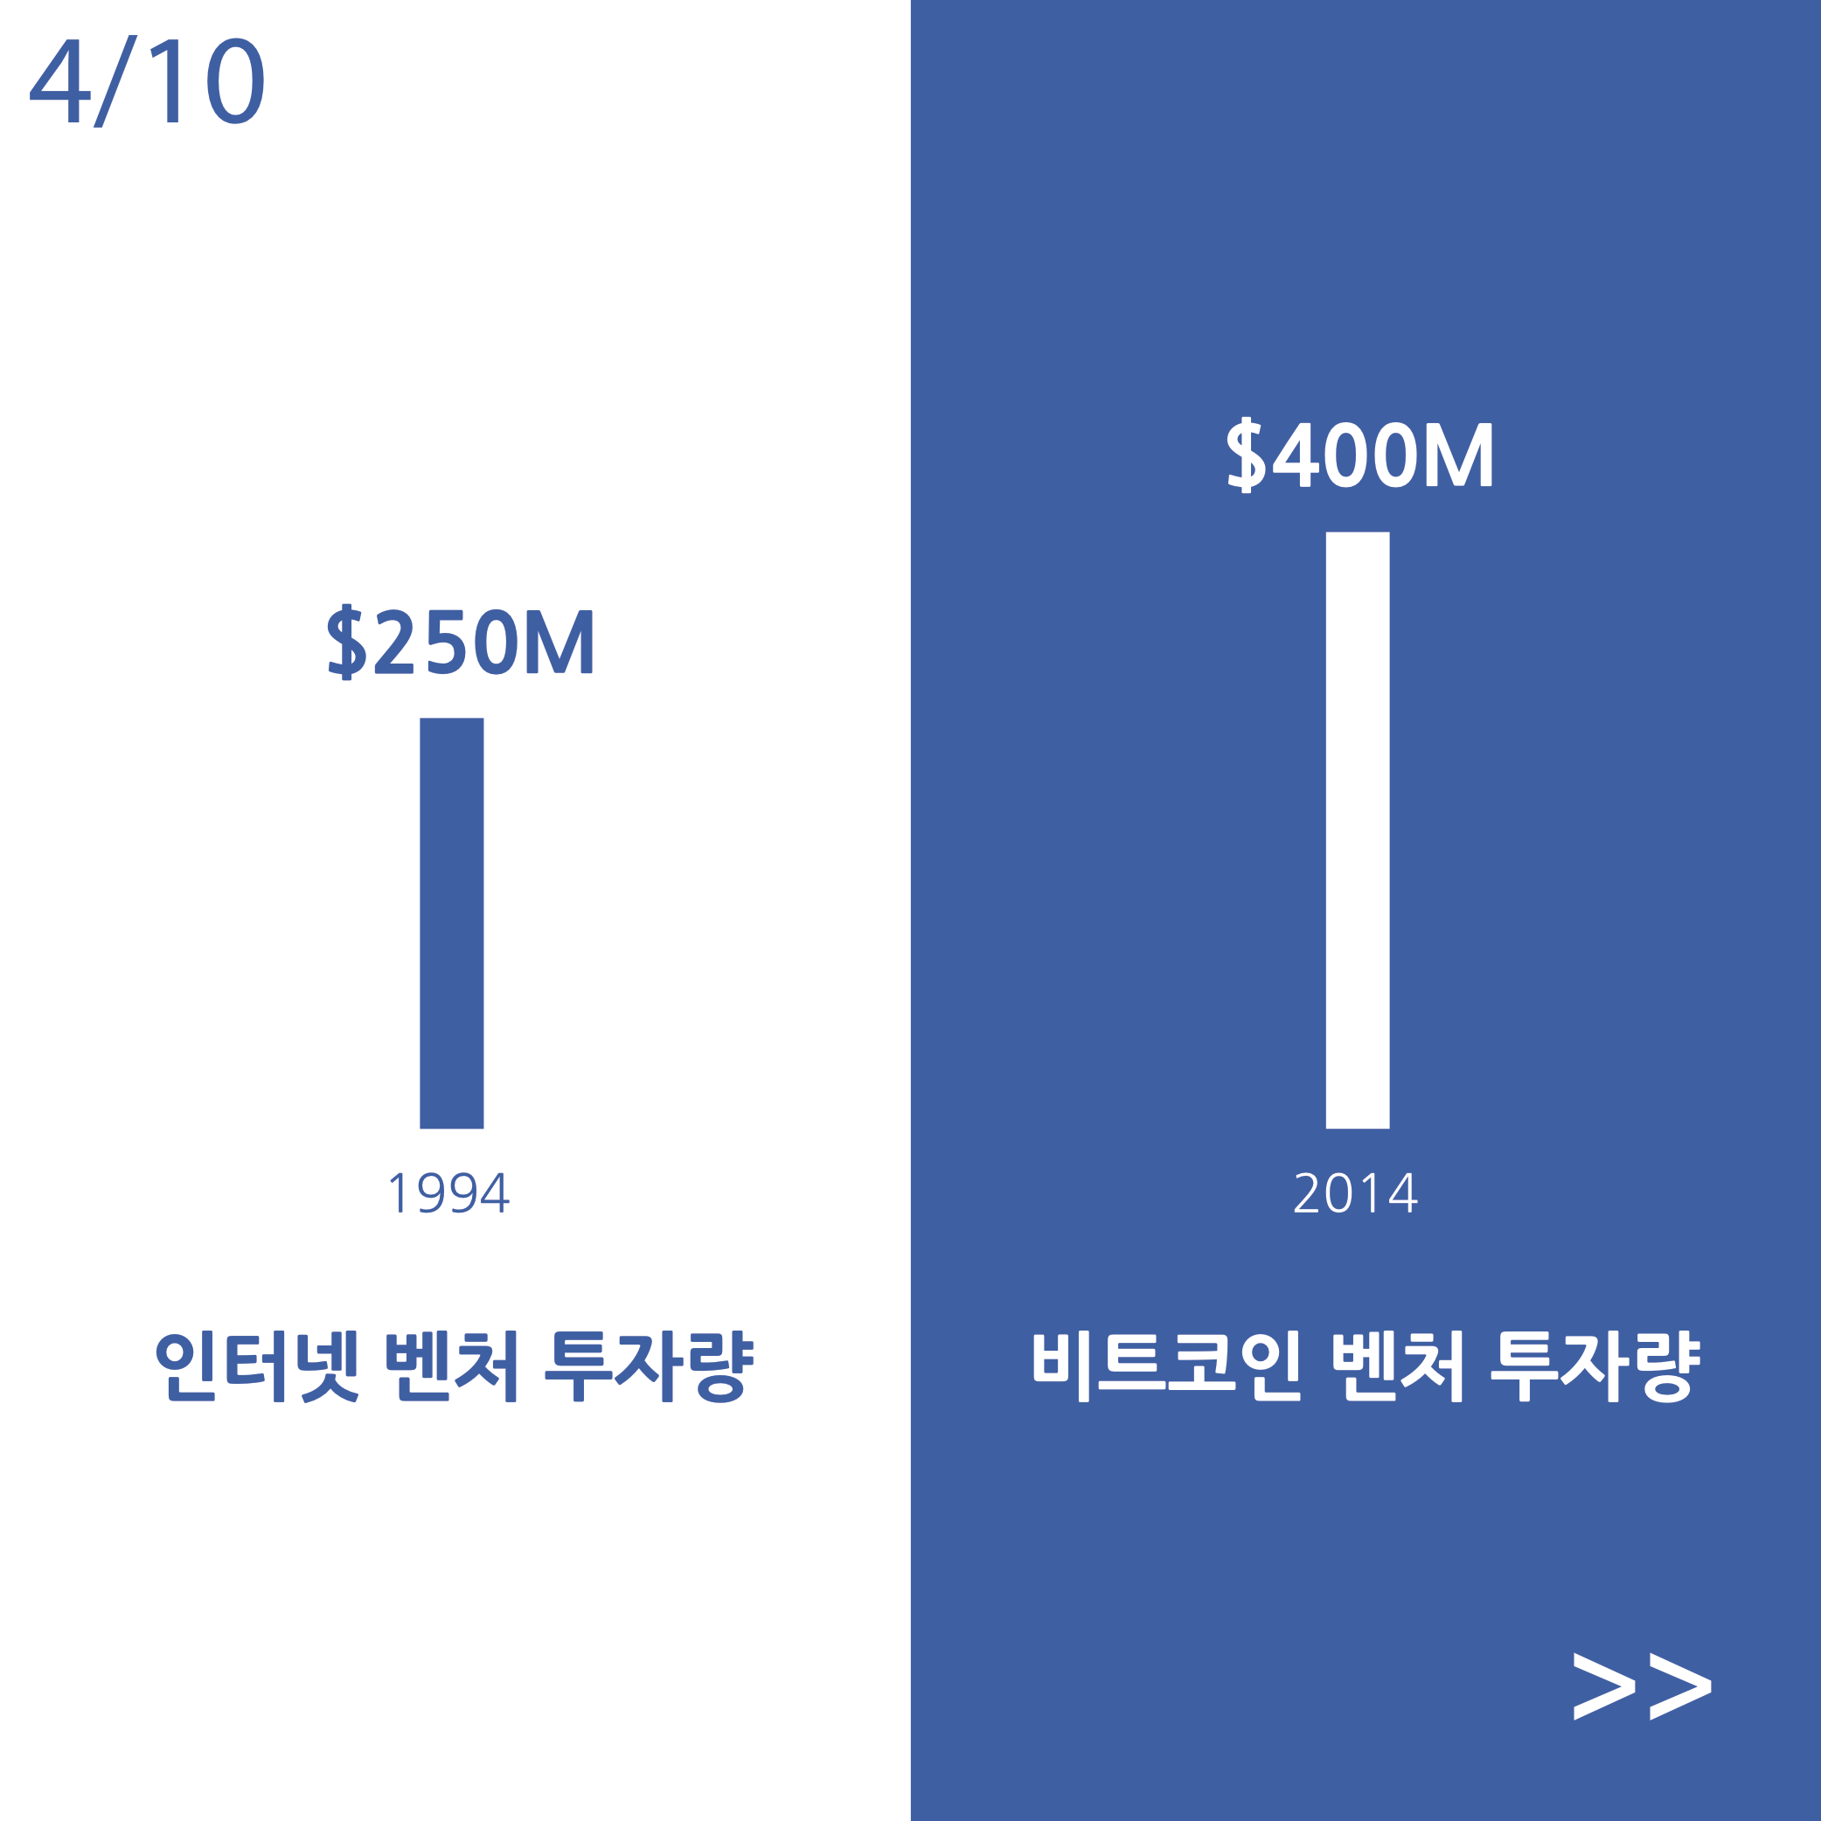

Slide 31
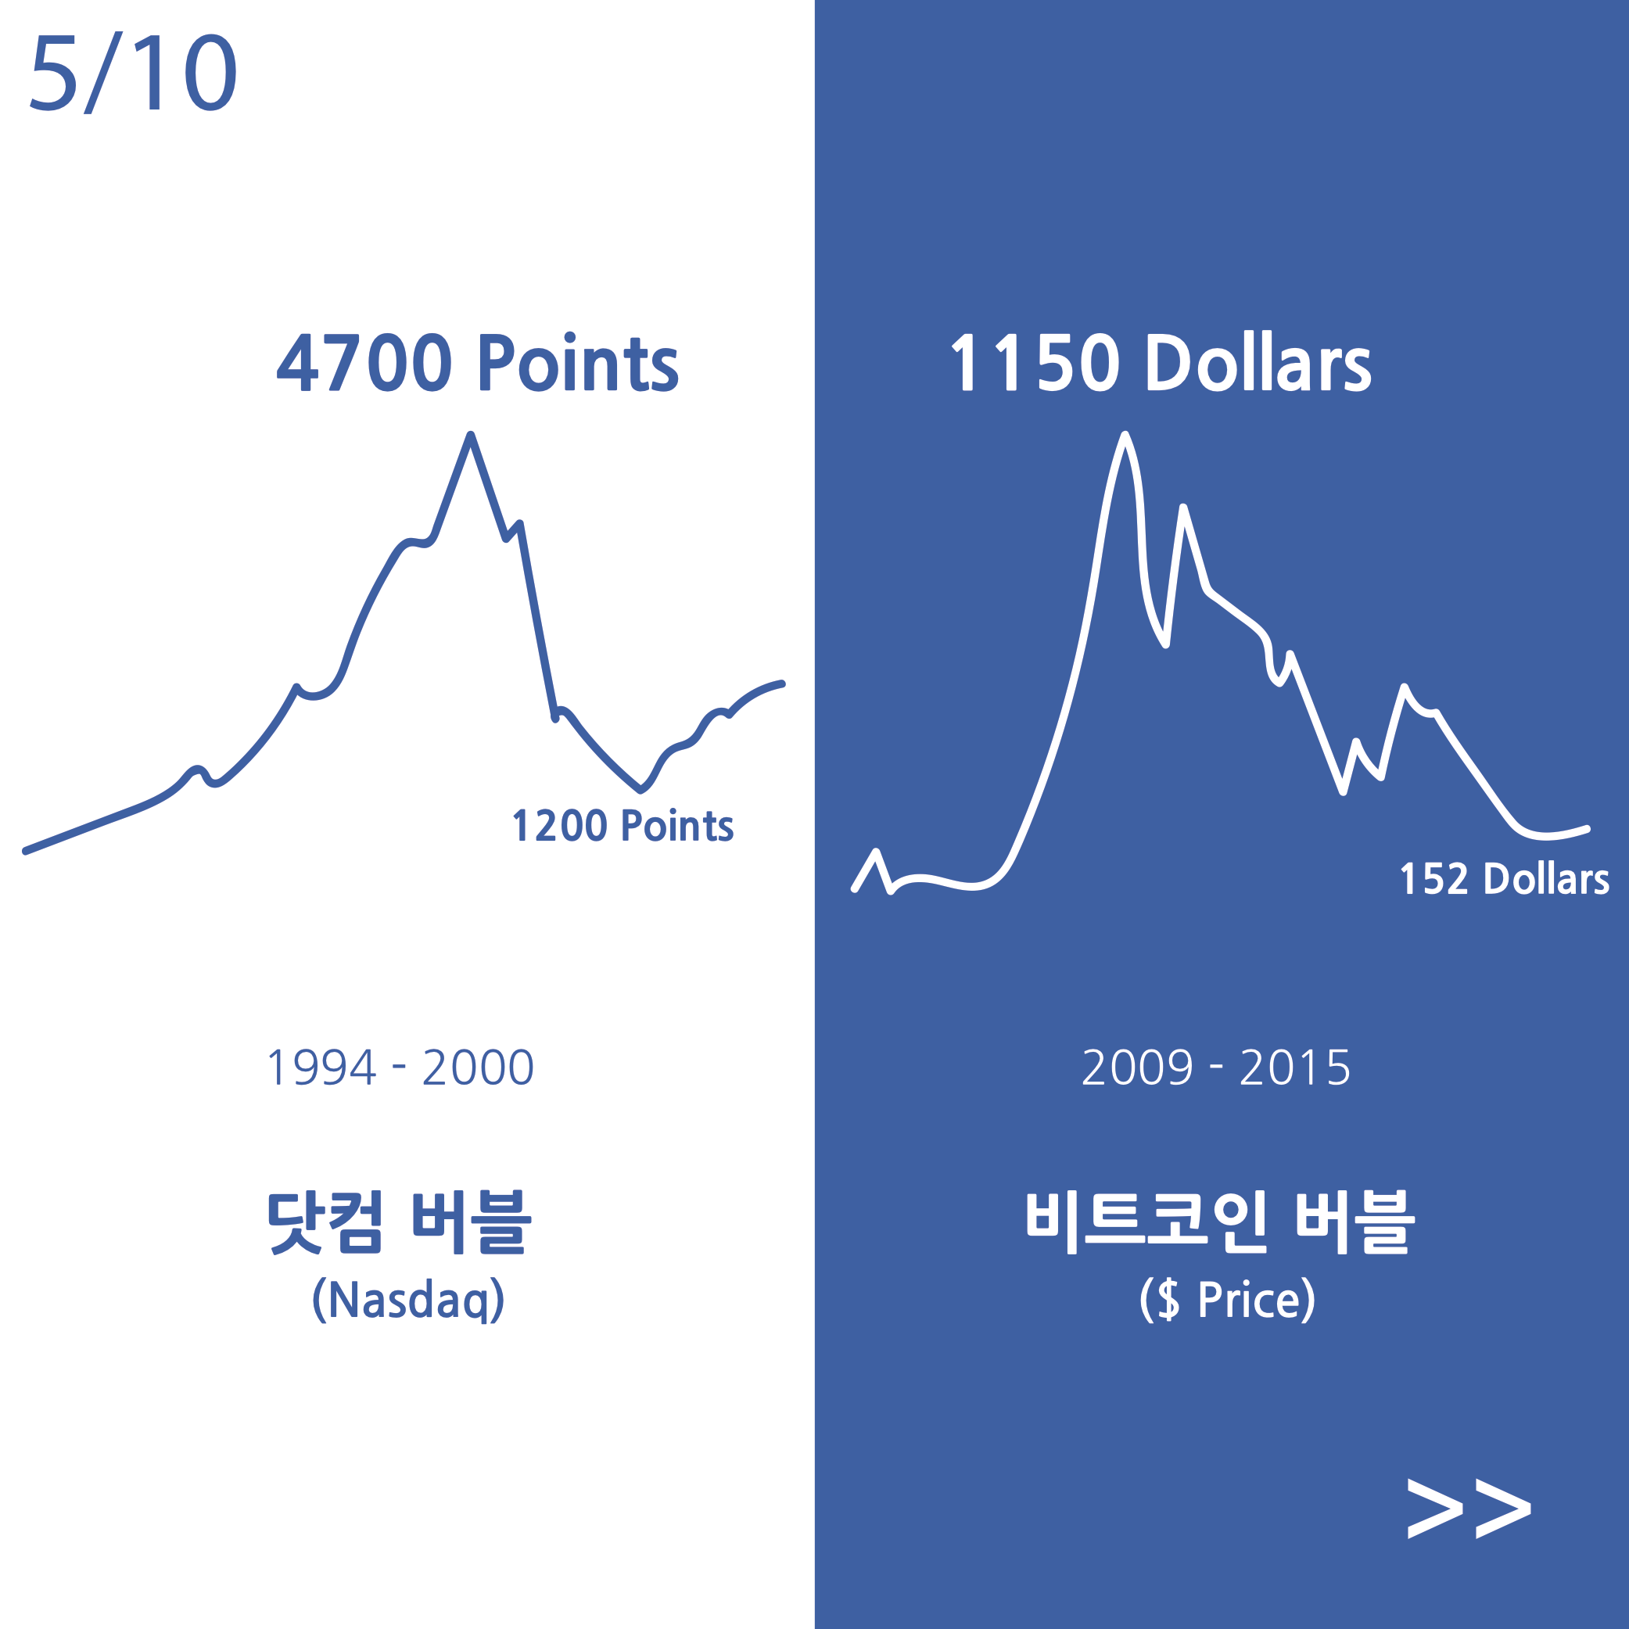

Slide 32
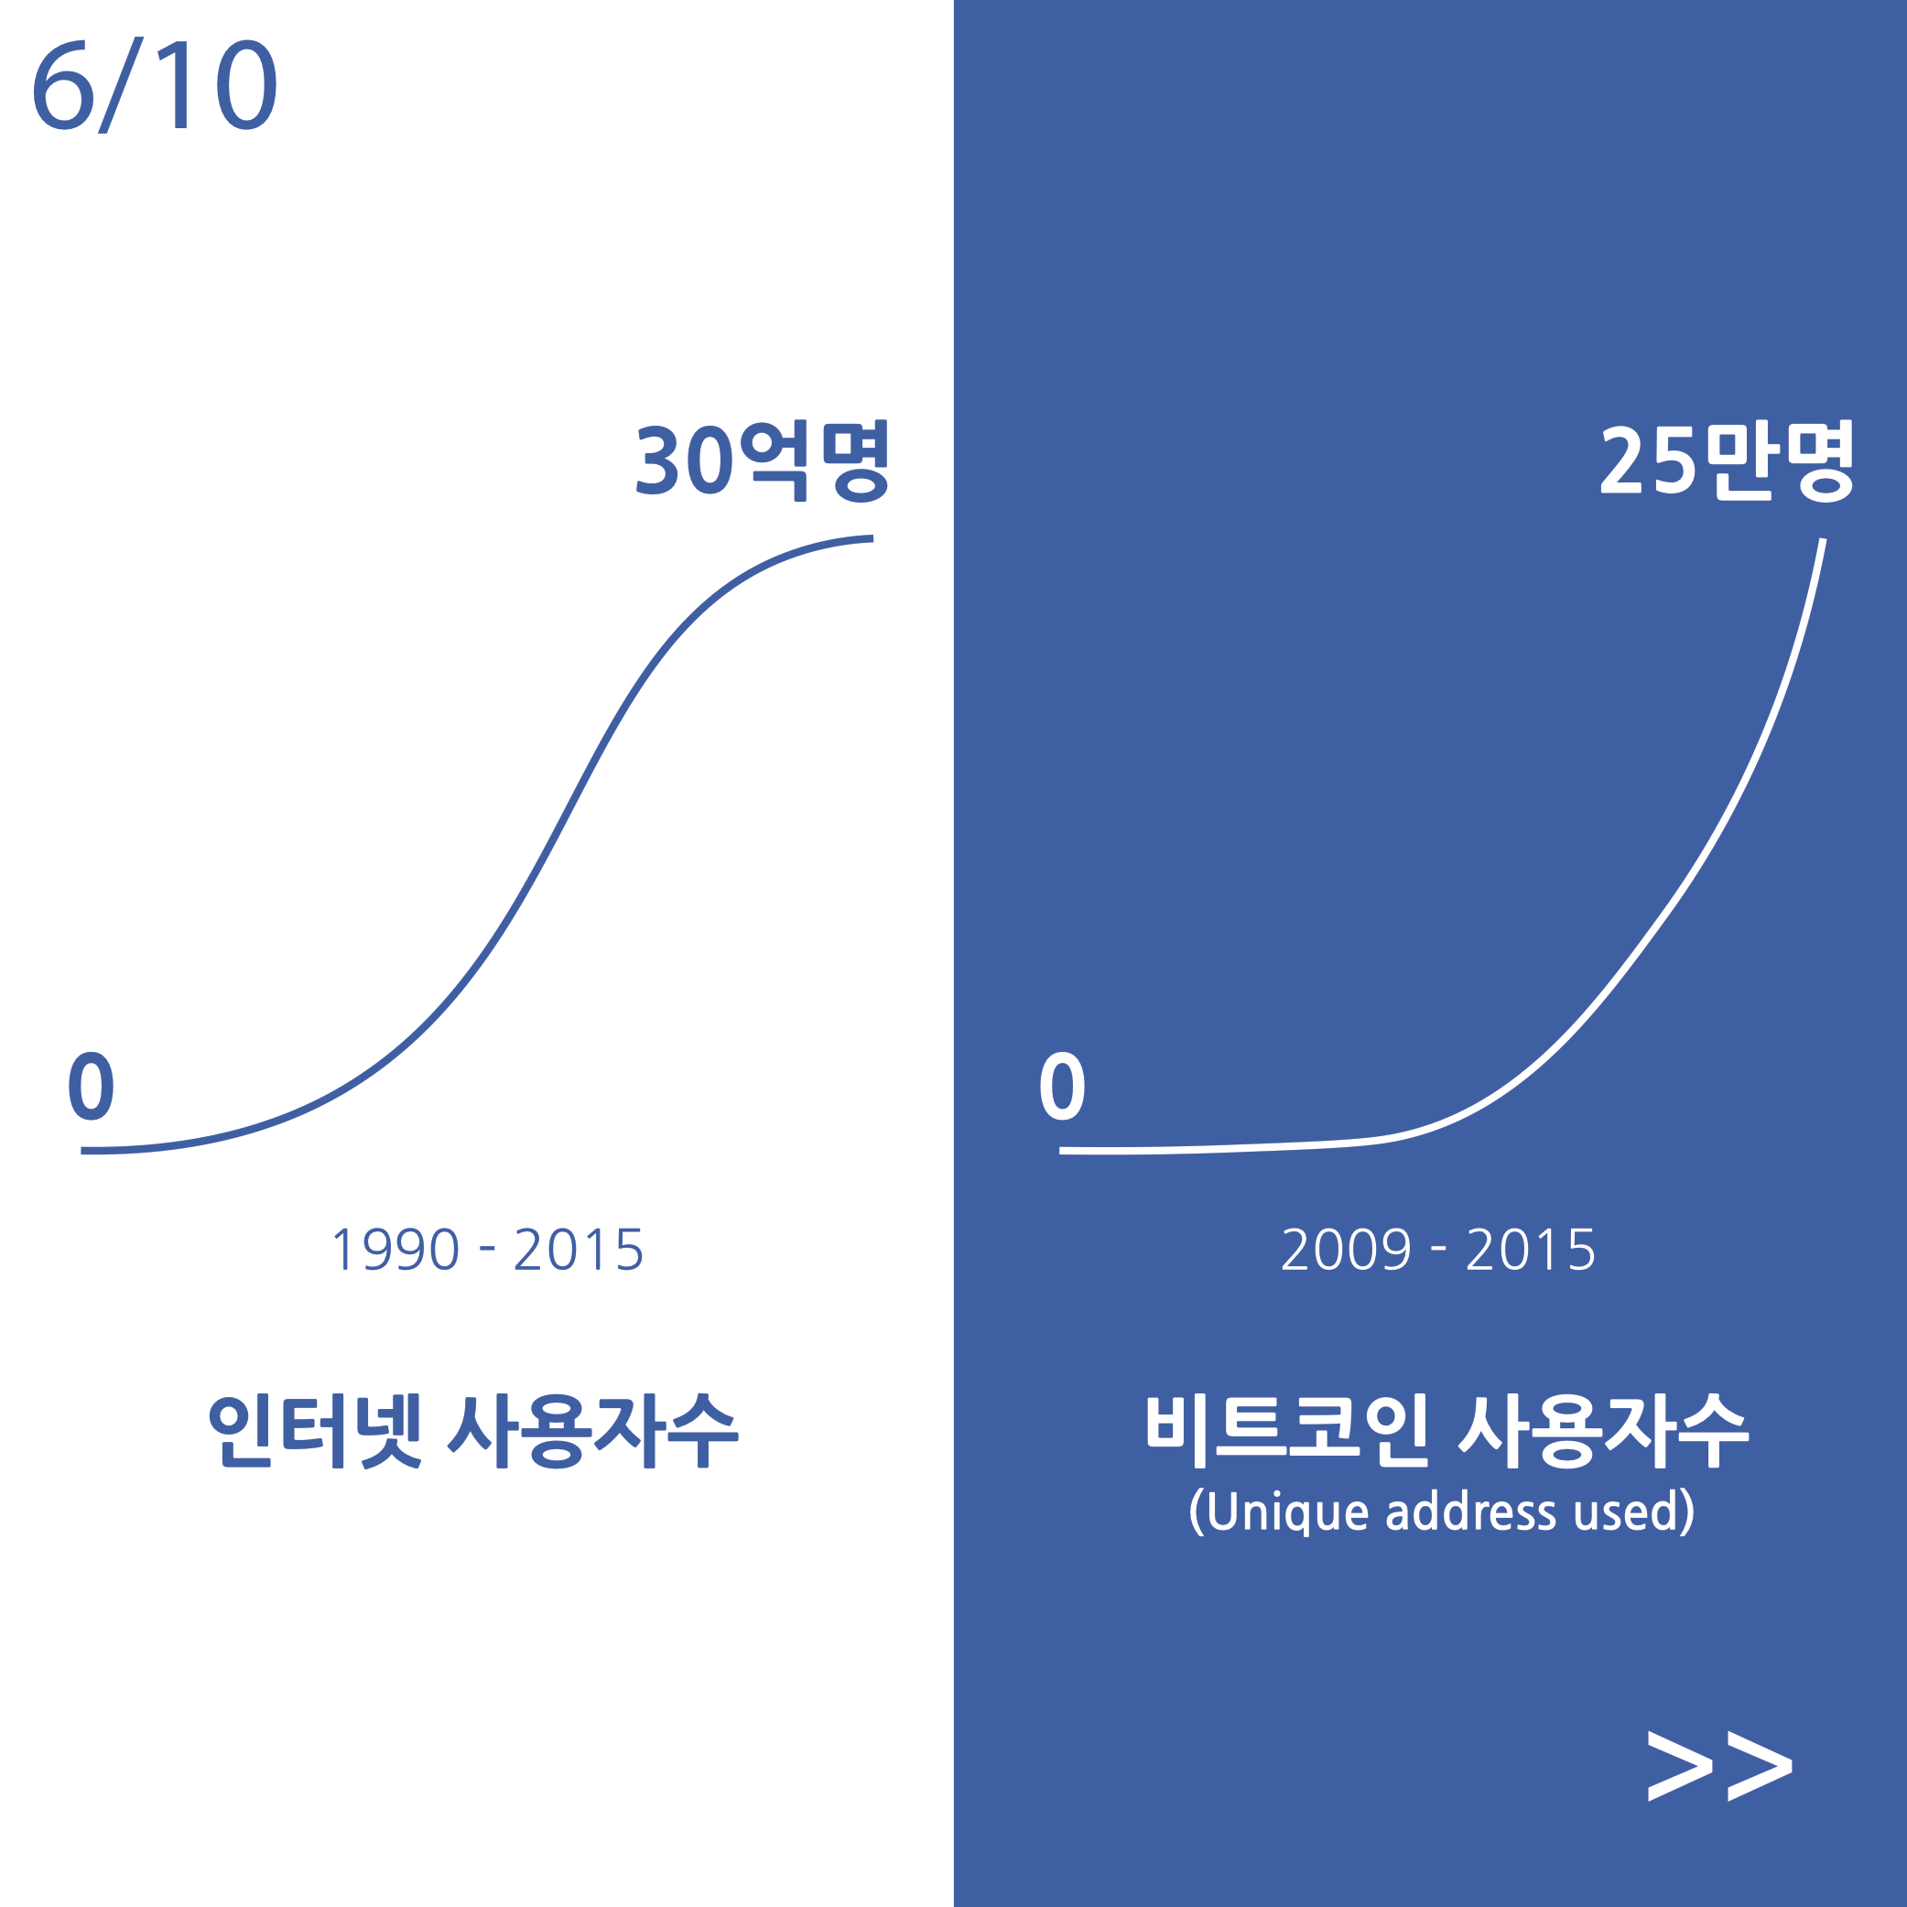

Slide 33


Slide 34


Slide 35
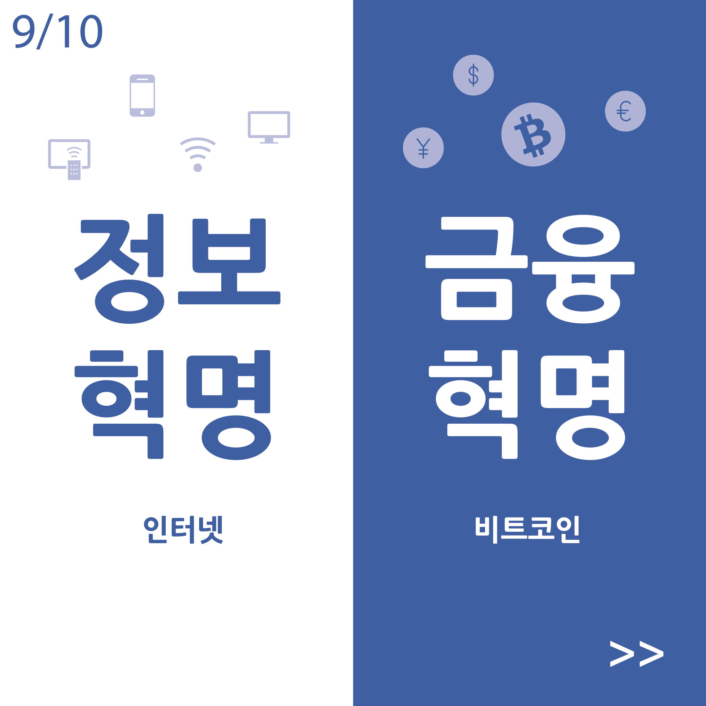

Slide 36


Slide 37
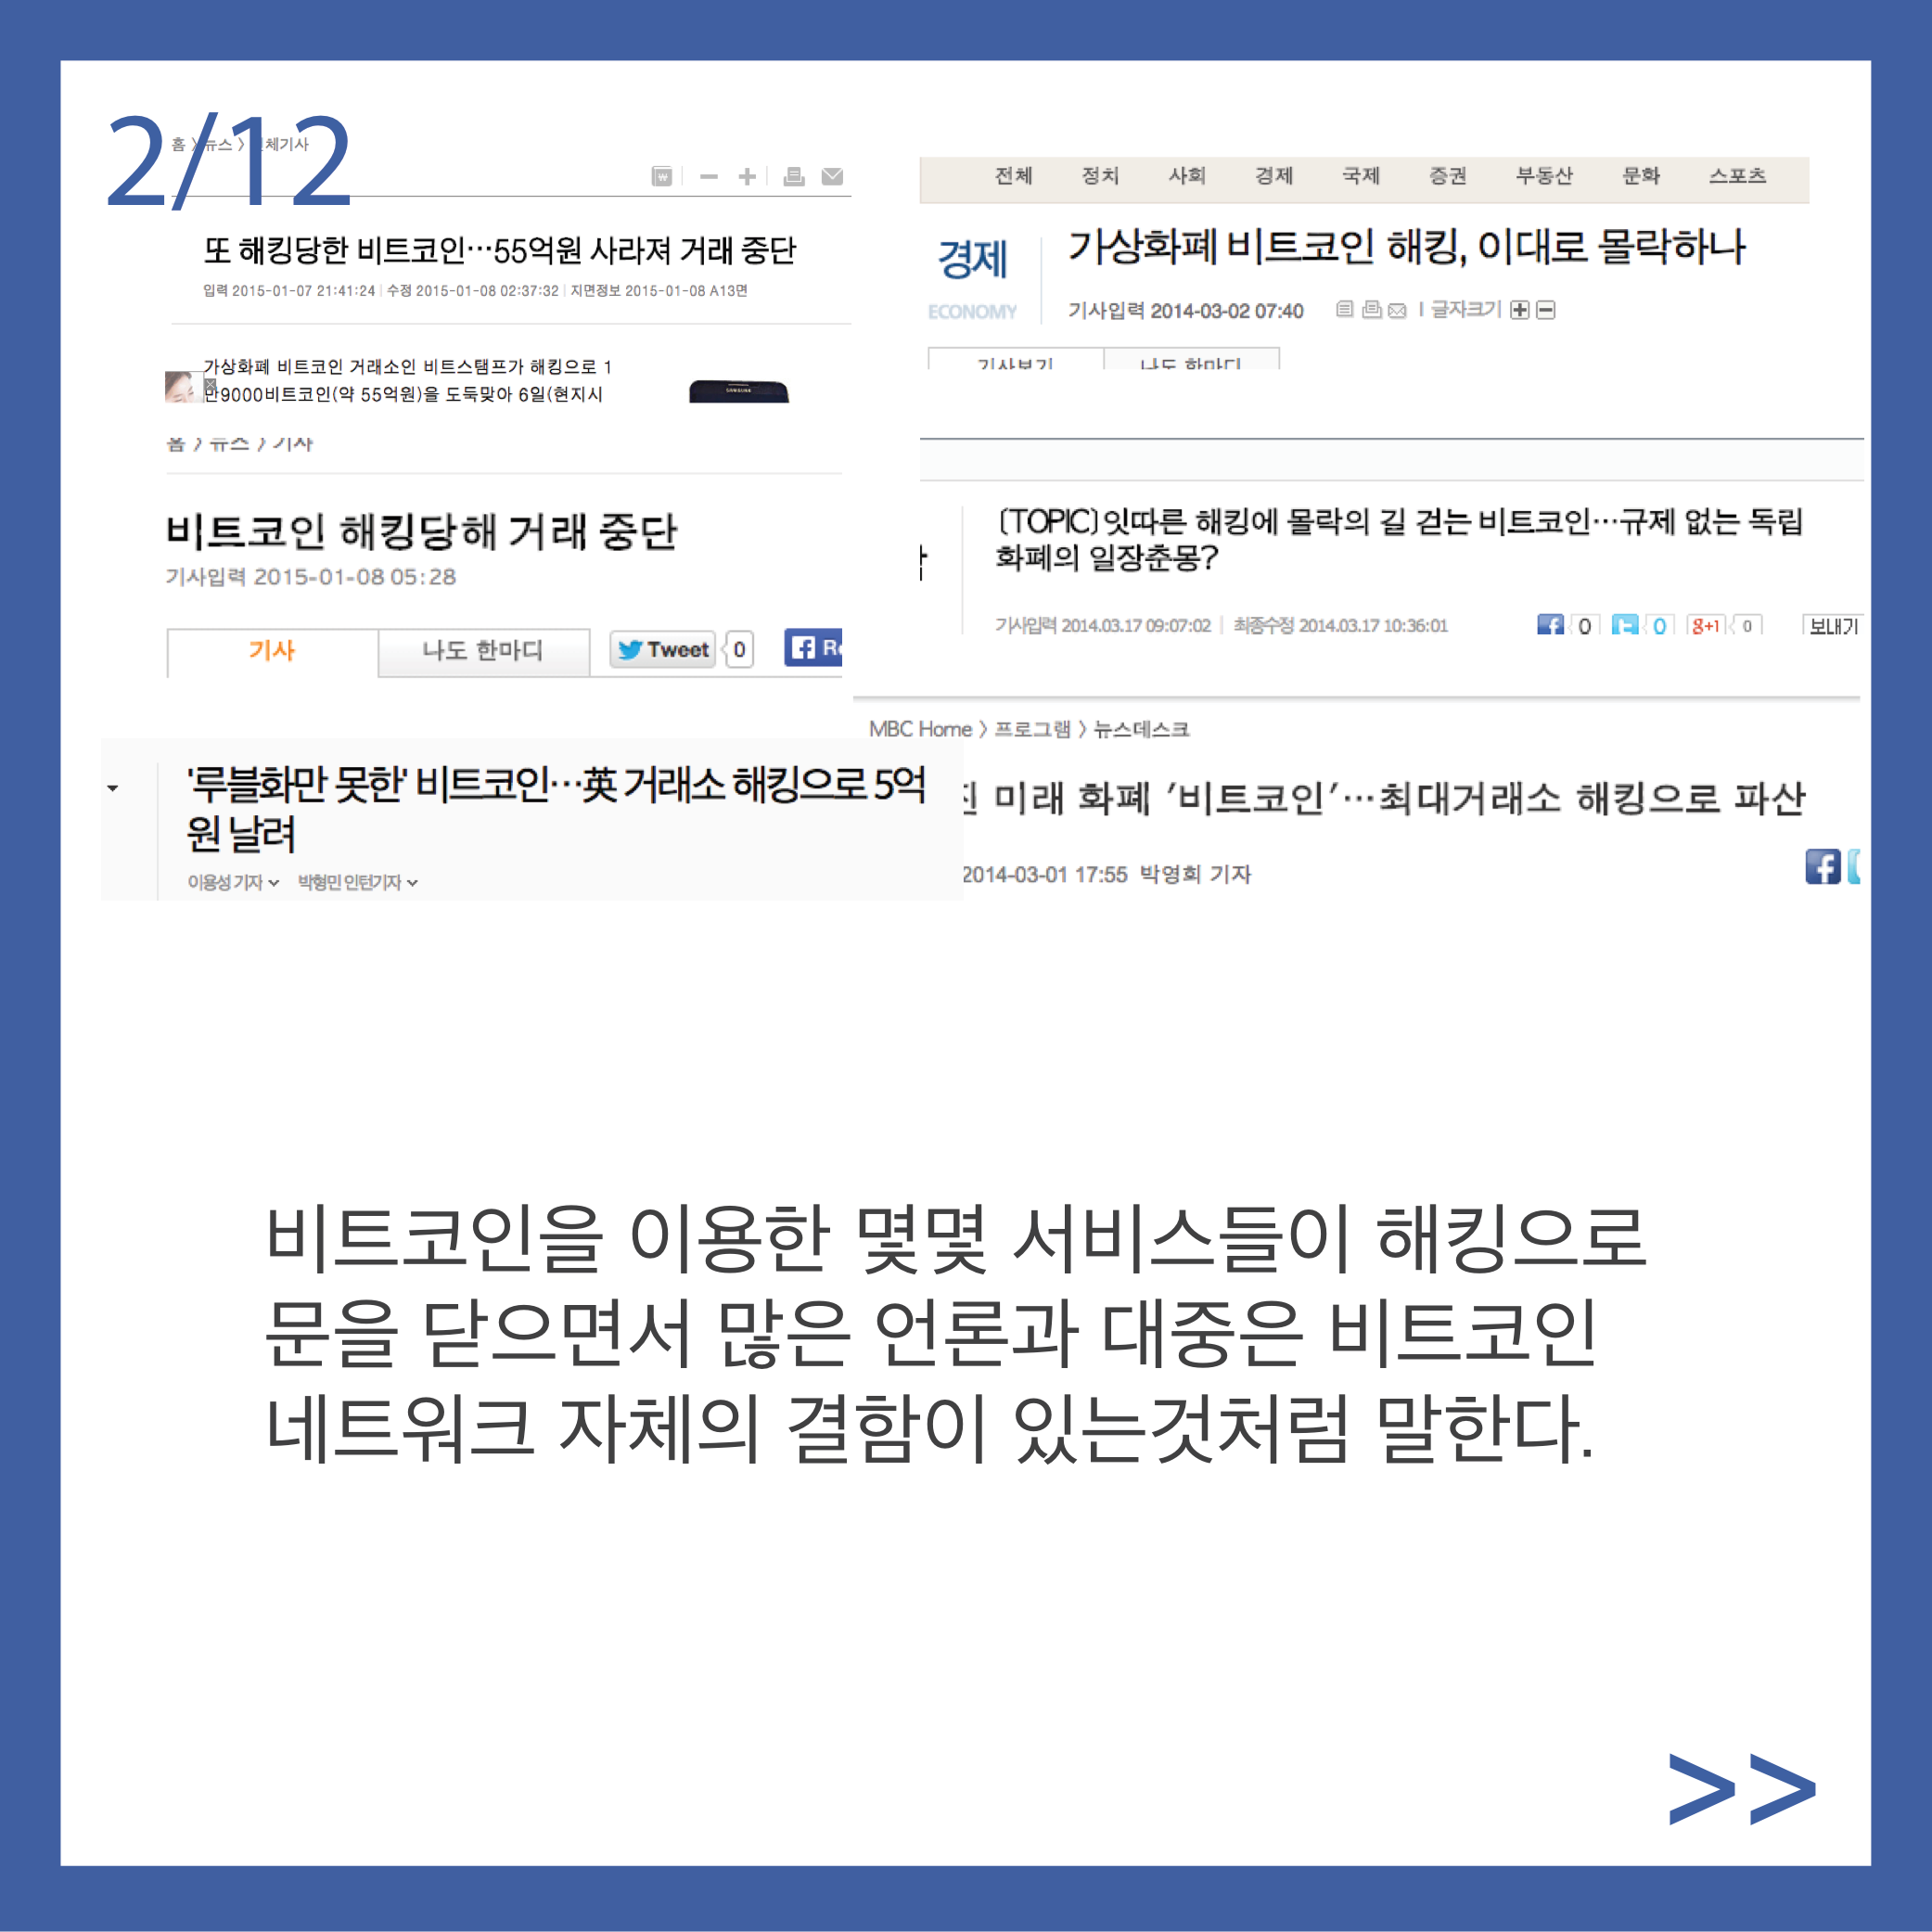

Slide 38
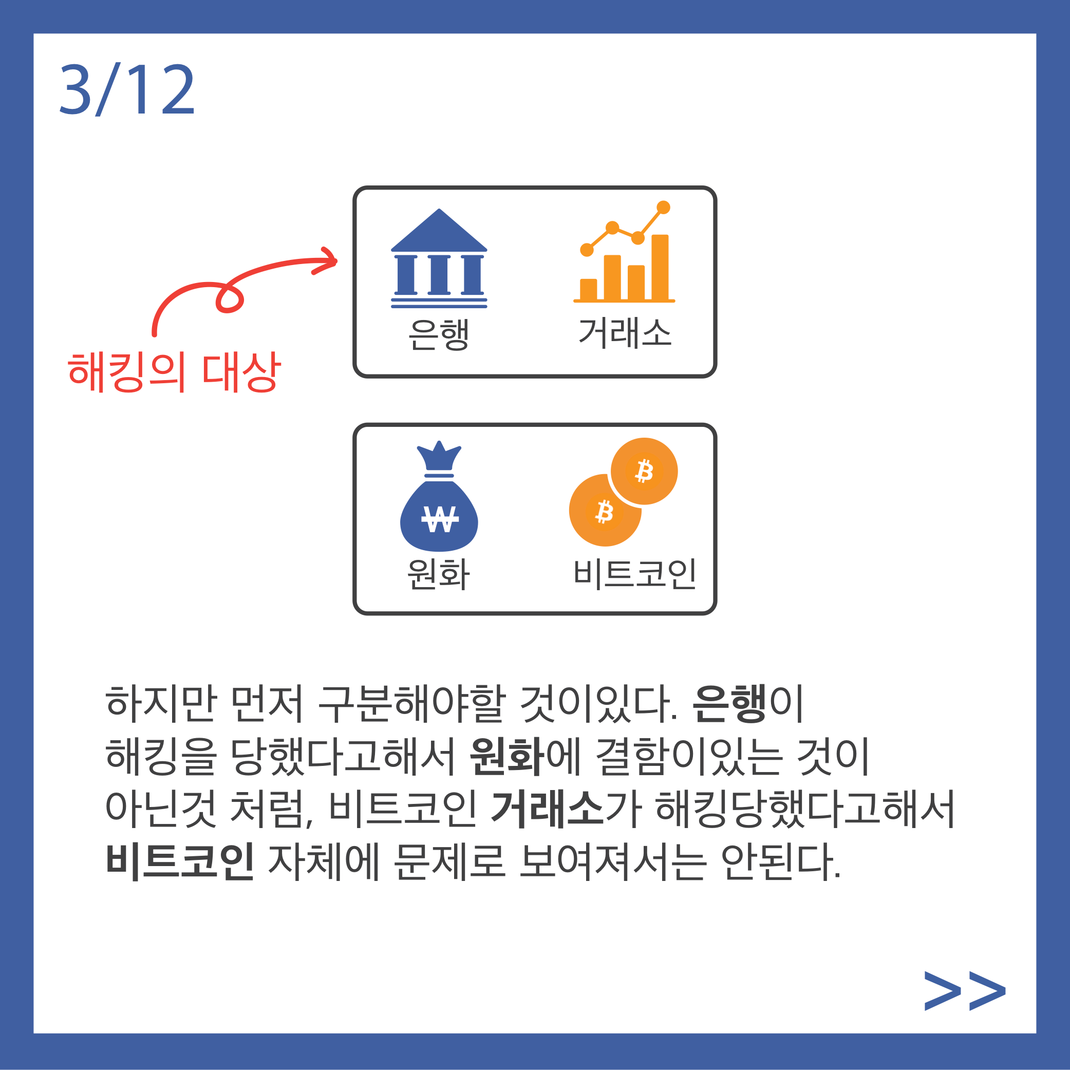

Slide 39
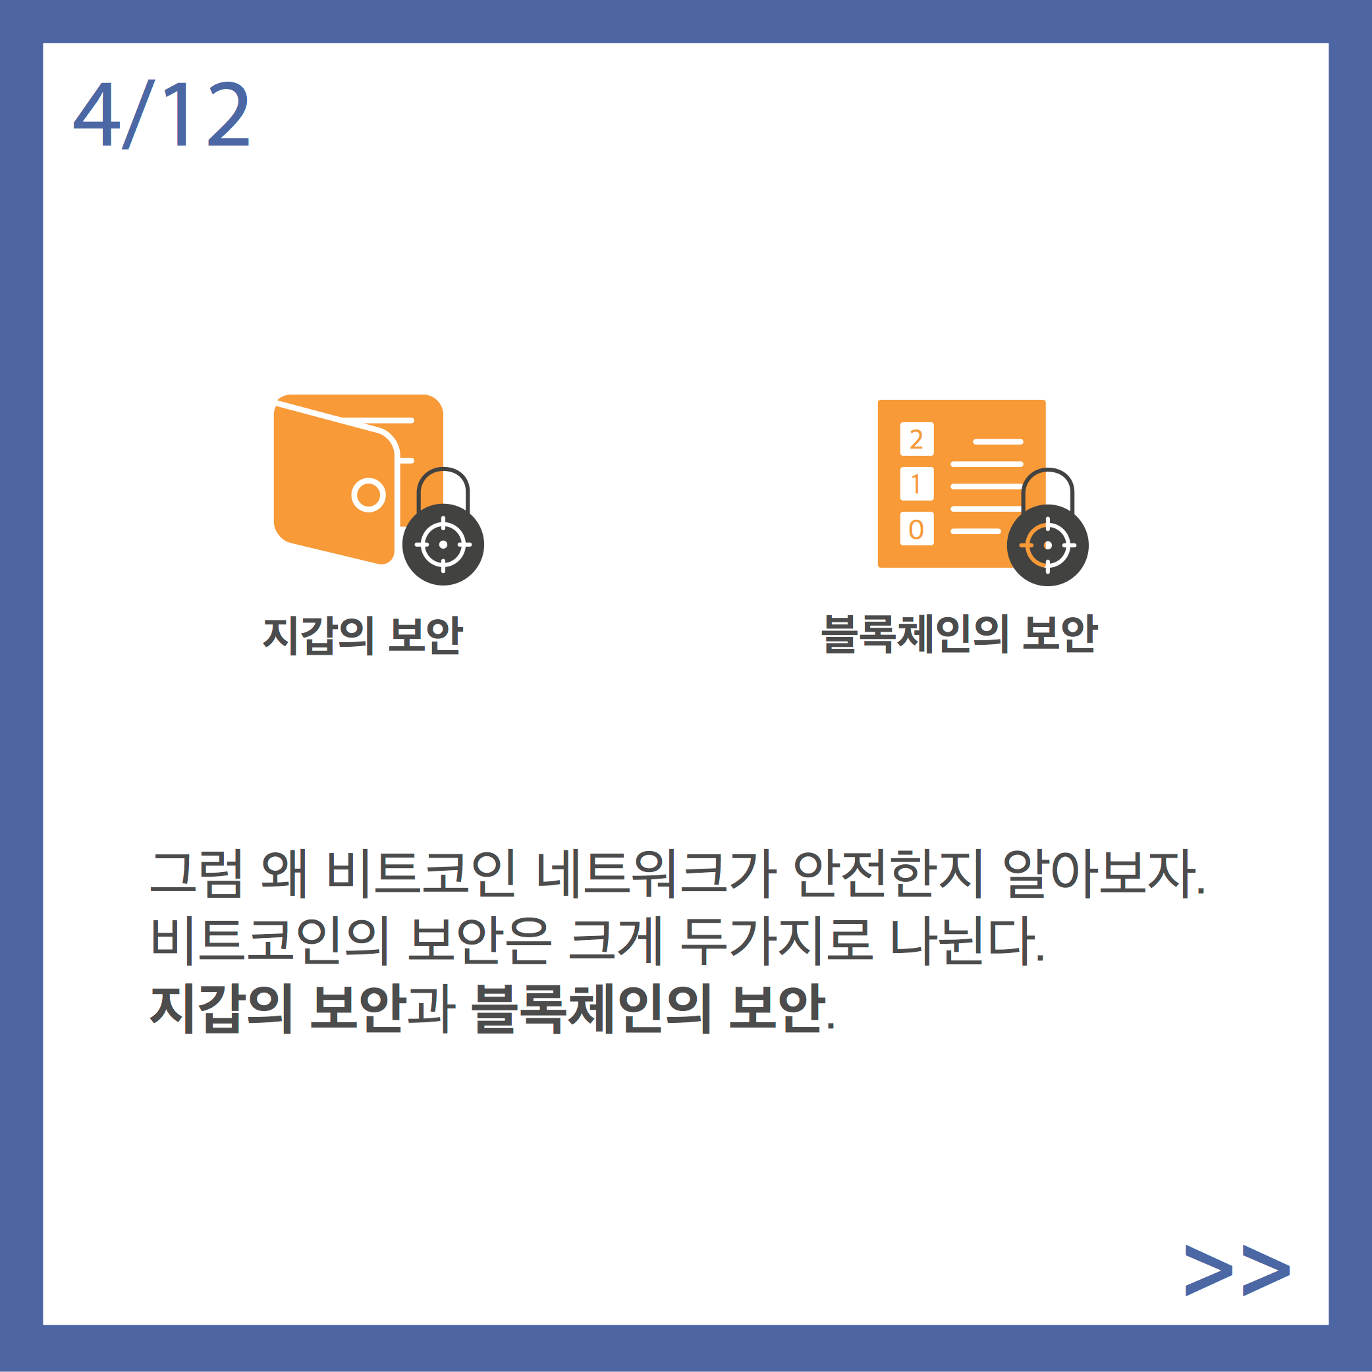

Slide 40
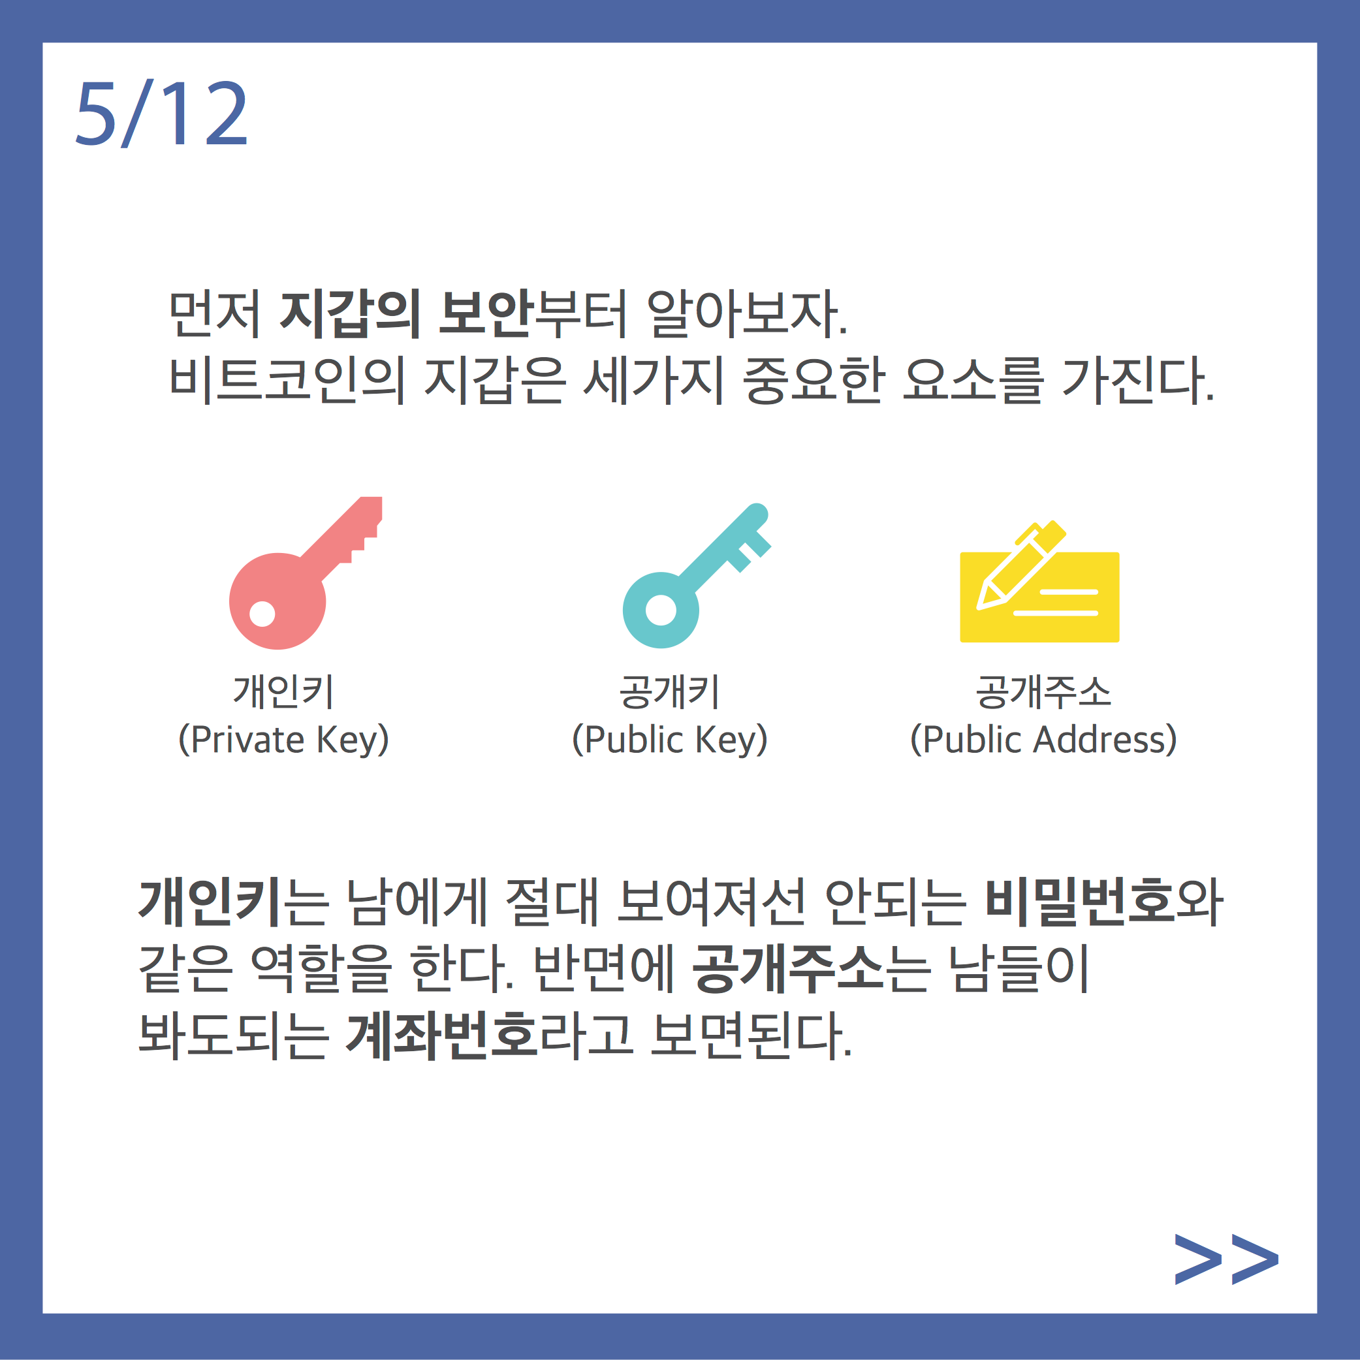

Slide 41
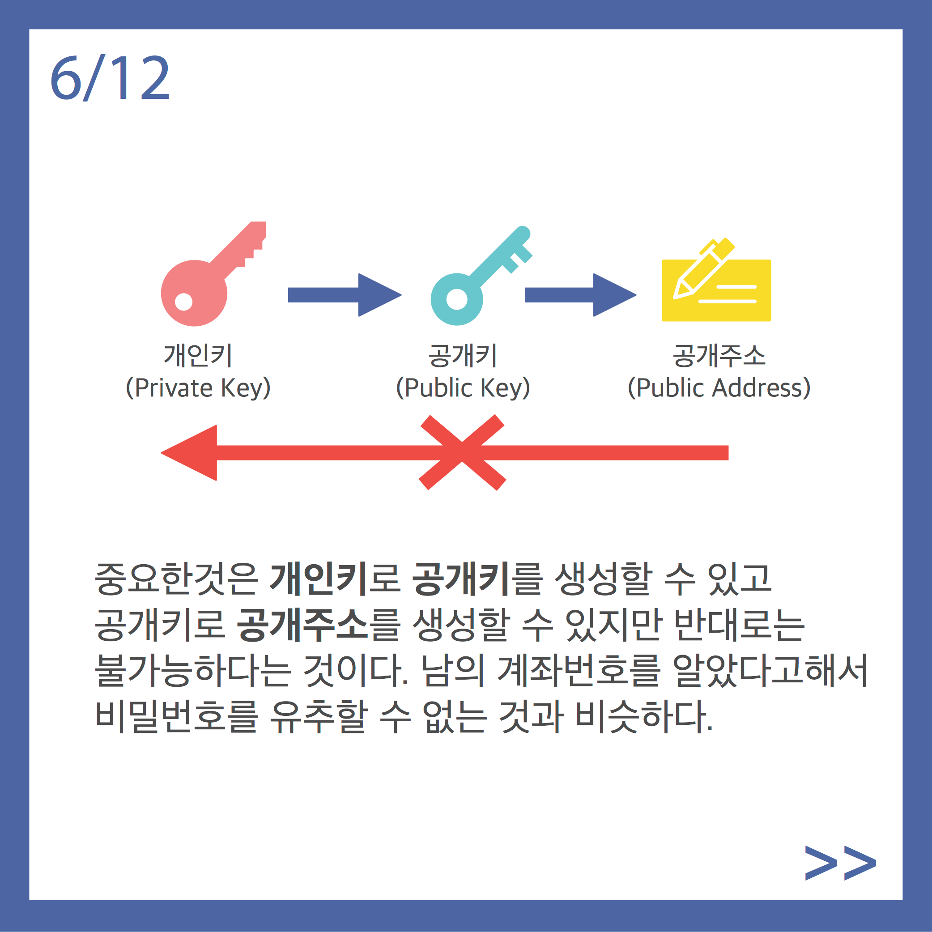

Slide 42
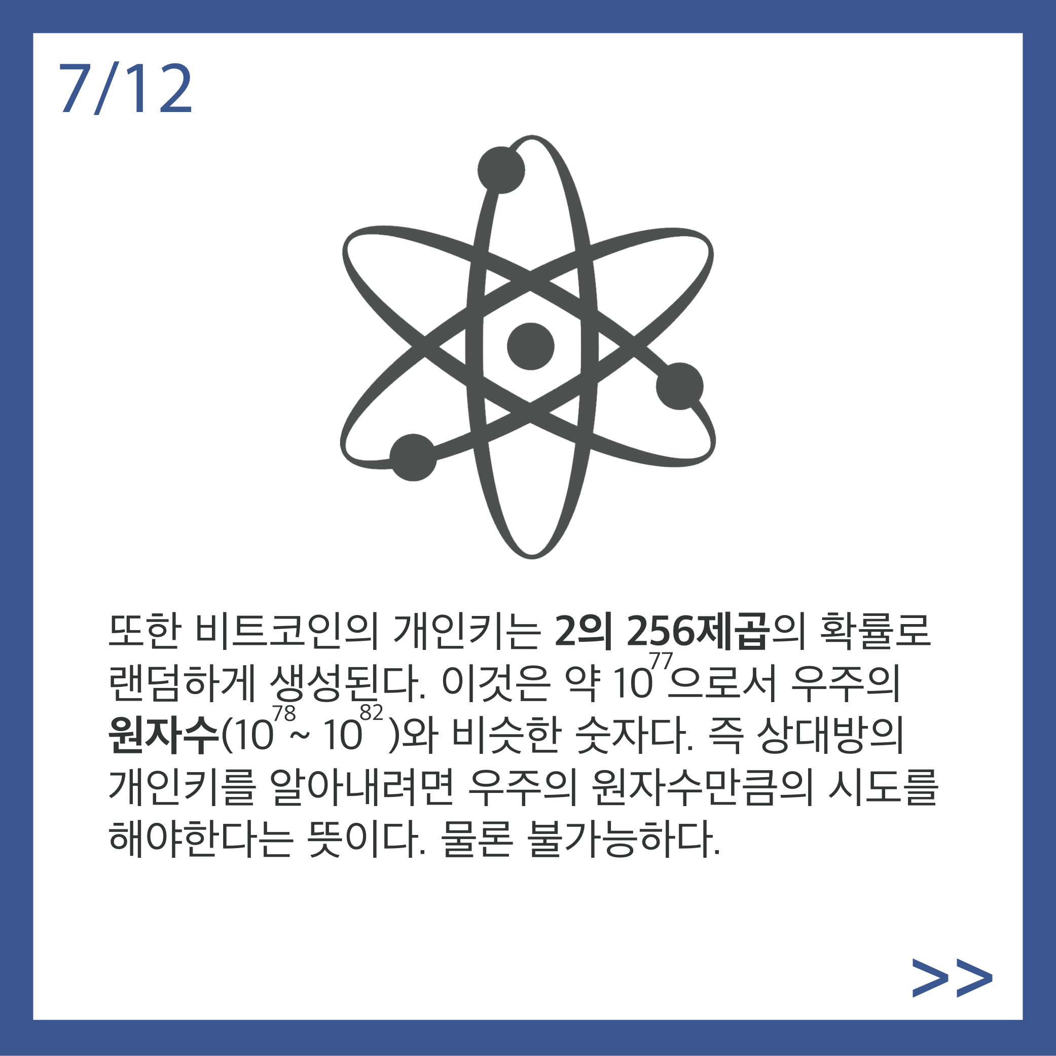

Slide 43
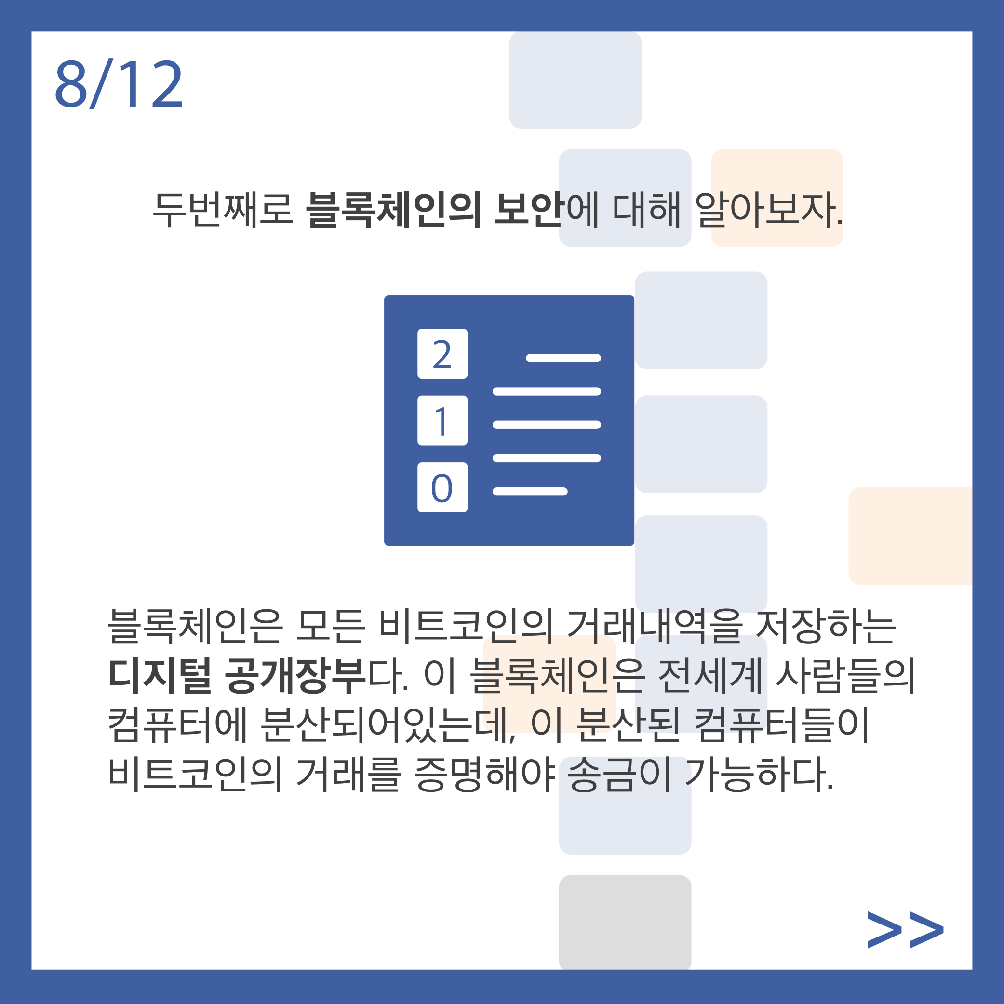

Slide 44
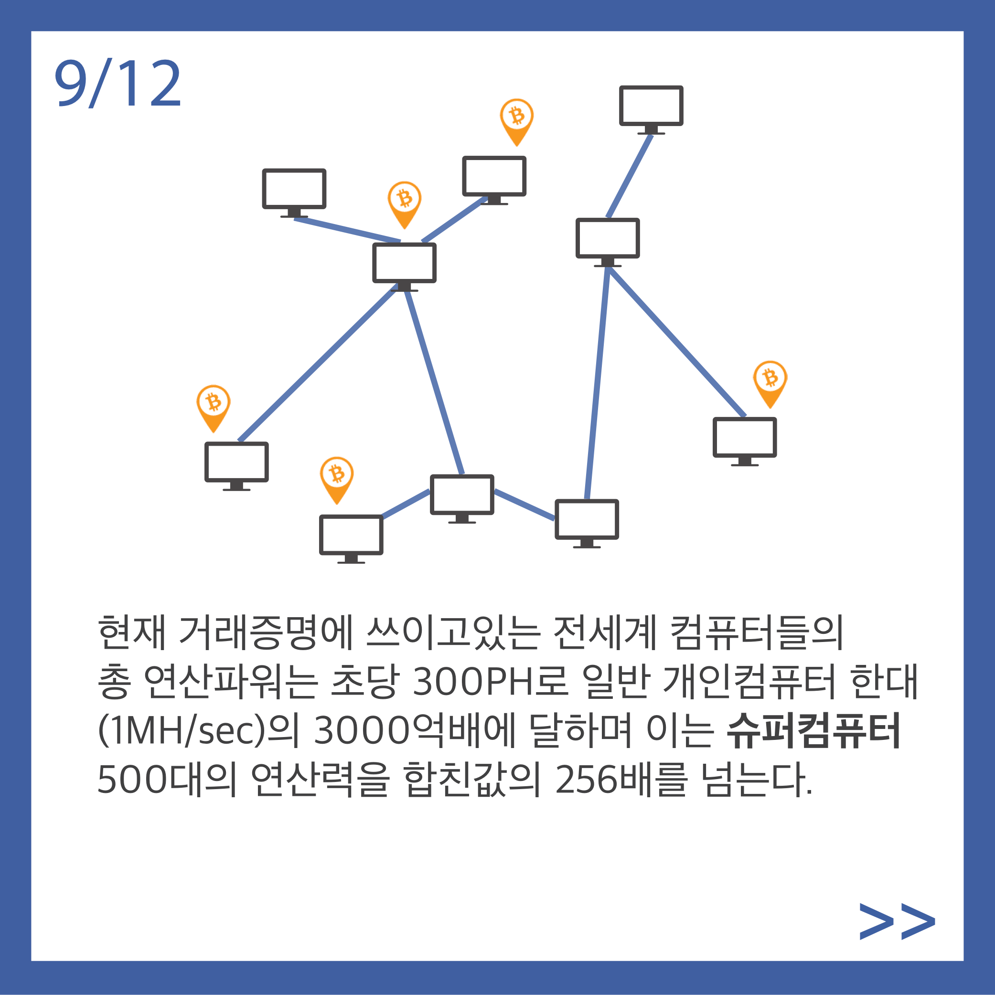

Slide 45
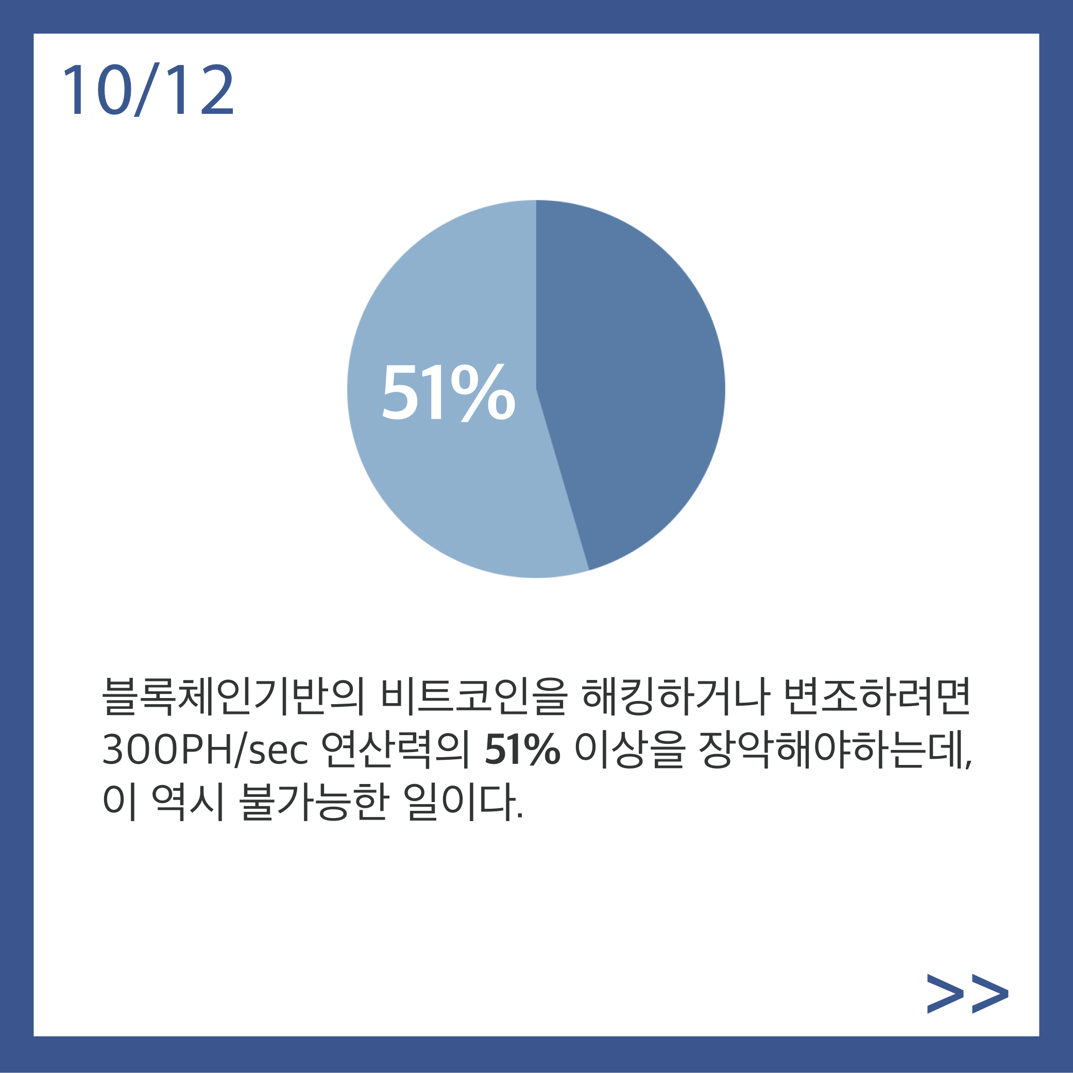

Slide 46


Slide 47
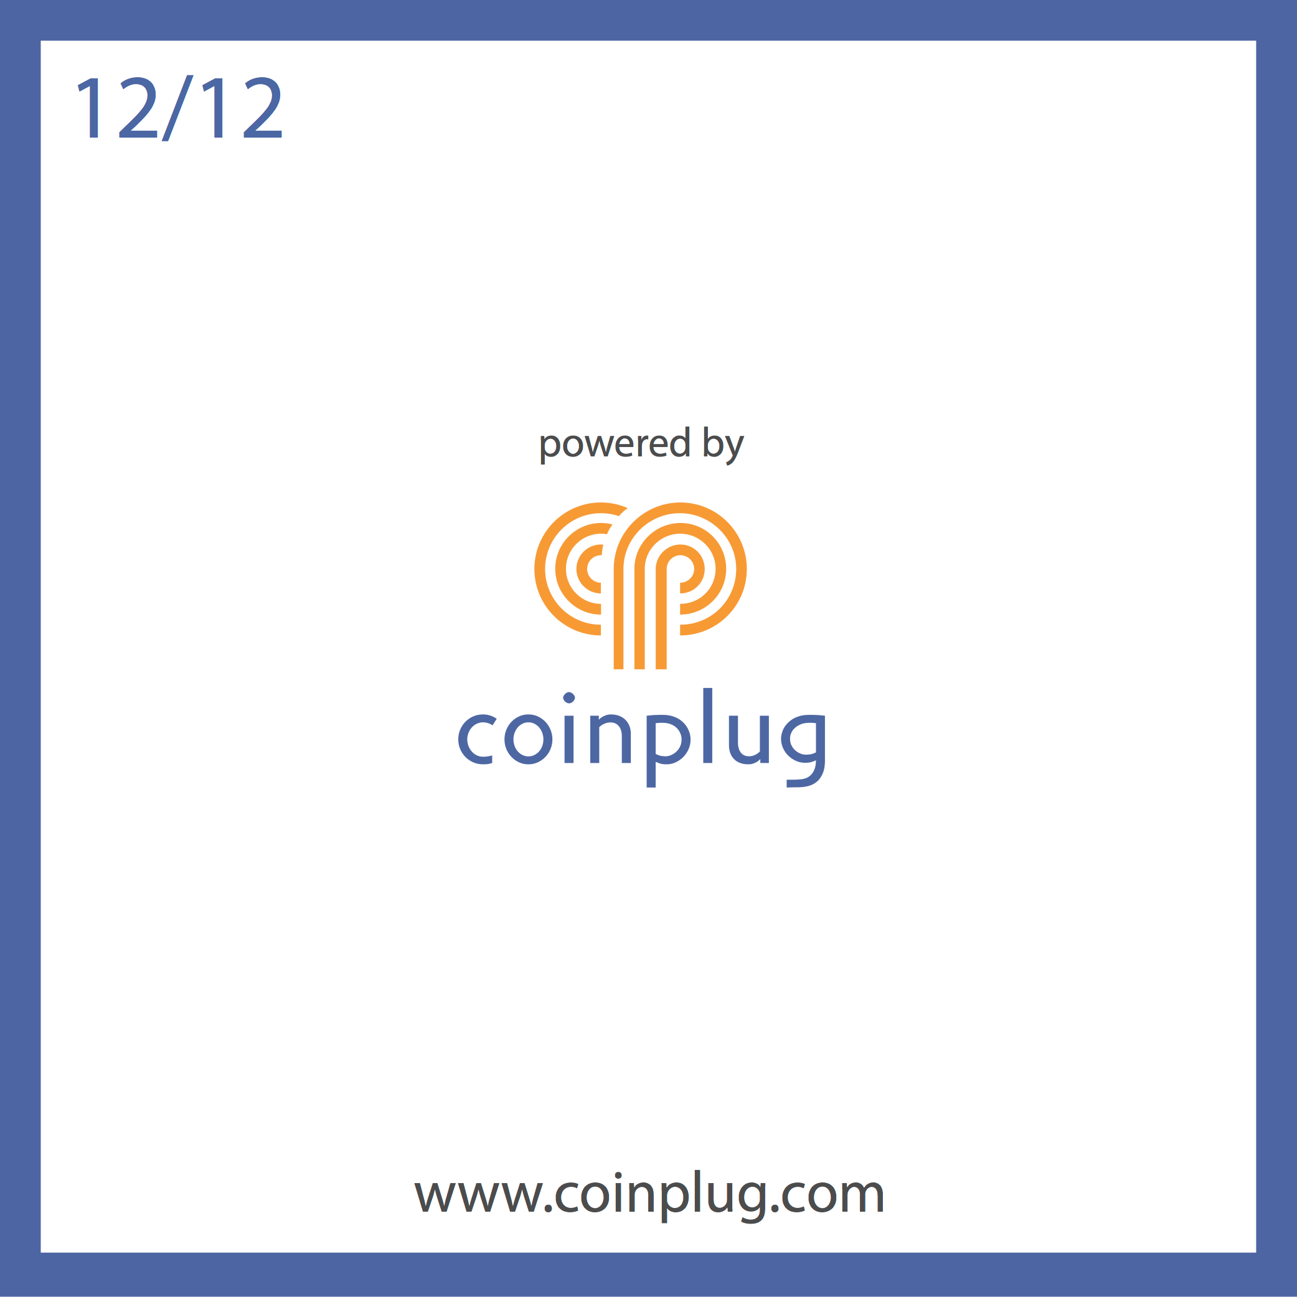

http://www.youtube.com/watch?v=lz6IQX7uDk4

